Slide 1
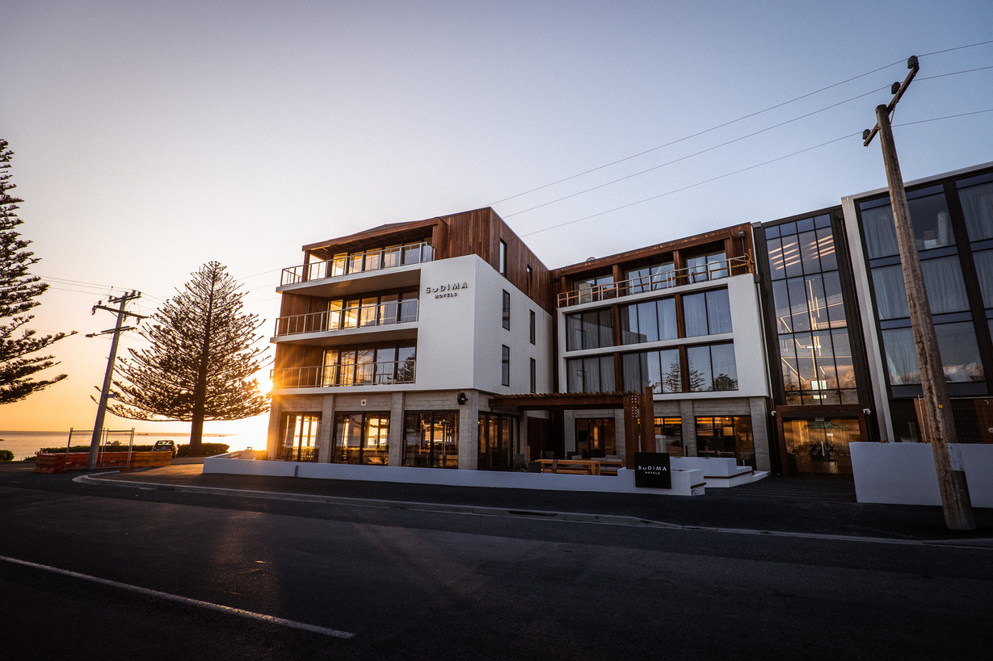
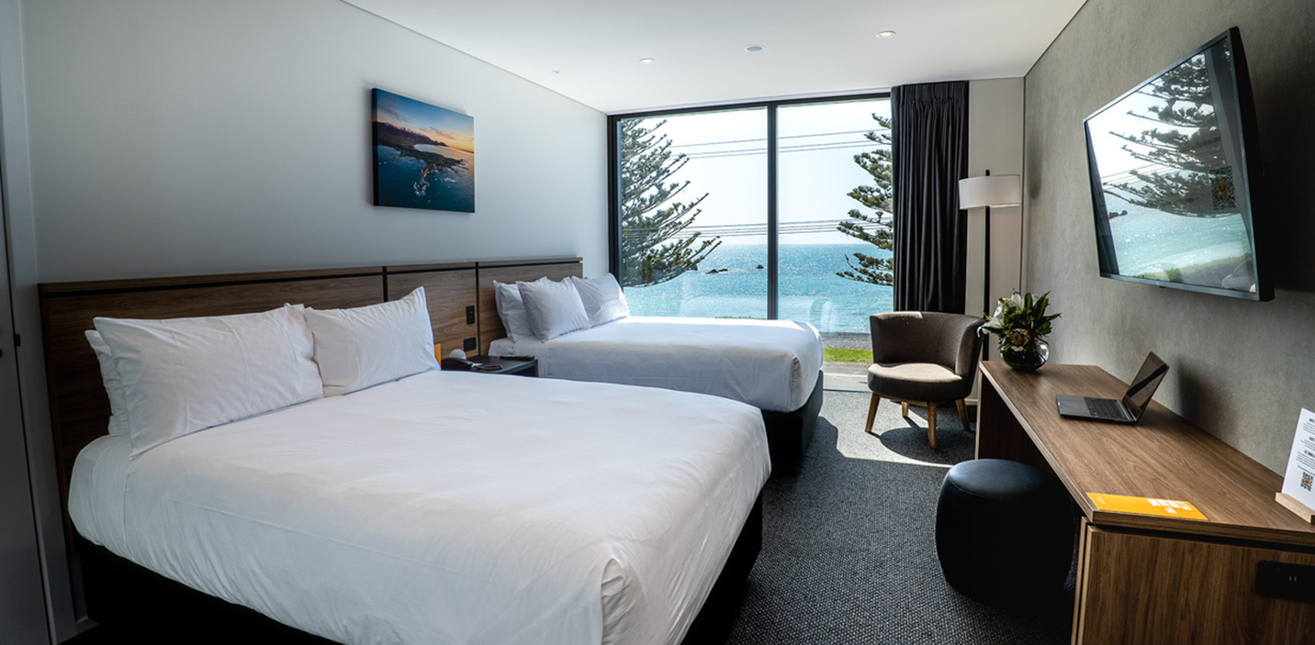

Sudima Kaikōura
4.5 star
Newest and biggest accommodation in Kaikōura.
3-5 USPs
120 rooms:
90 Superior rooms (27 King / 63 Twin)
27 Superior Ocean View (12 King / 15 Twin)
3 Suites
3 Three bedroom suites (suite + ocean view rooms combined)
Additional info:
Restaurant & bar,
Gym, outdoor heated infinity pool,
1 to 2 Conference spaces.
Contact details:
Trade: Michel Adolphe (Western Markets)
michela@sudimahotels.com
Daniel Zhang (Asia) danielz@sudimahotels.com
Res.: reservations@sudimahotels.com

Slide 2
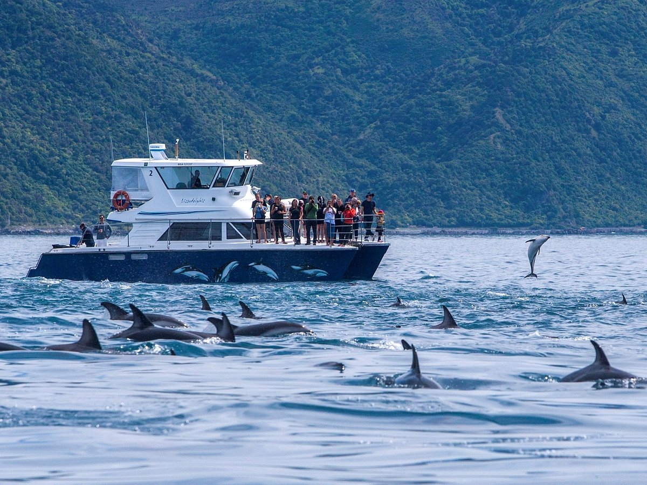
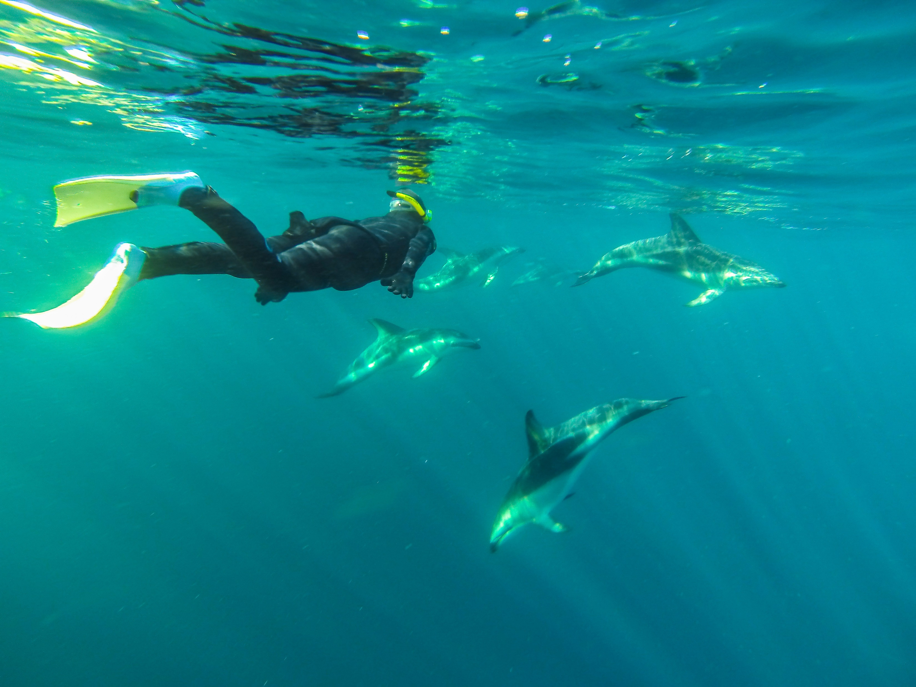
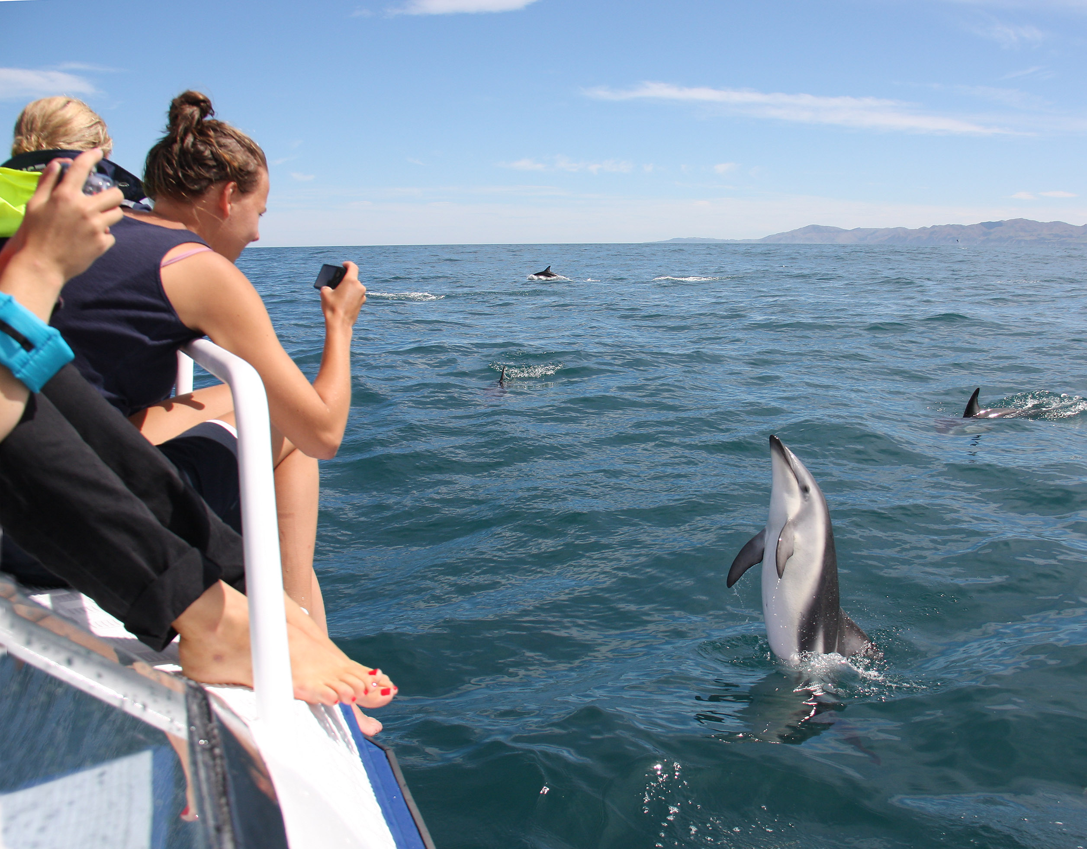


Dolphin Encounter
3-5 USPs
Year round? Seasonal attraction?
Best season to see the dolphins
Bucket list item
Operational details:
Departure / End times (summer / winter)
Duration
Time in the water
How many people on the boat?
How many swimmers / watchers?
Do you provide transportation to the boat?
Additional info:
Towels available for hire ($20 bond / $2 hire)
Café on site.
Contact details:
Trade: Lynette Buurman
lynette@dolphin.co.nz
027 224 4937
Res.: info@dolphin.co.nz

Slide 3


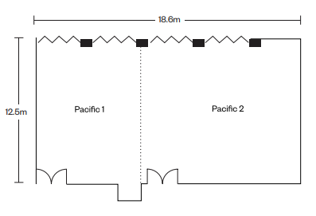

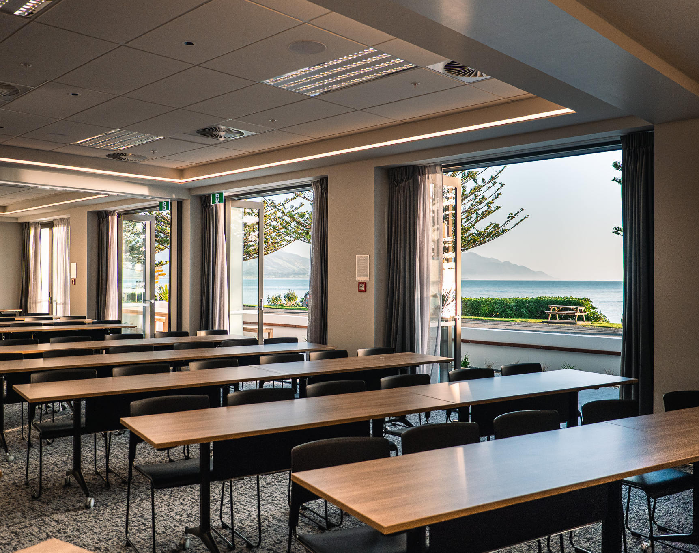




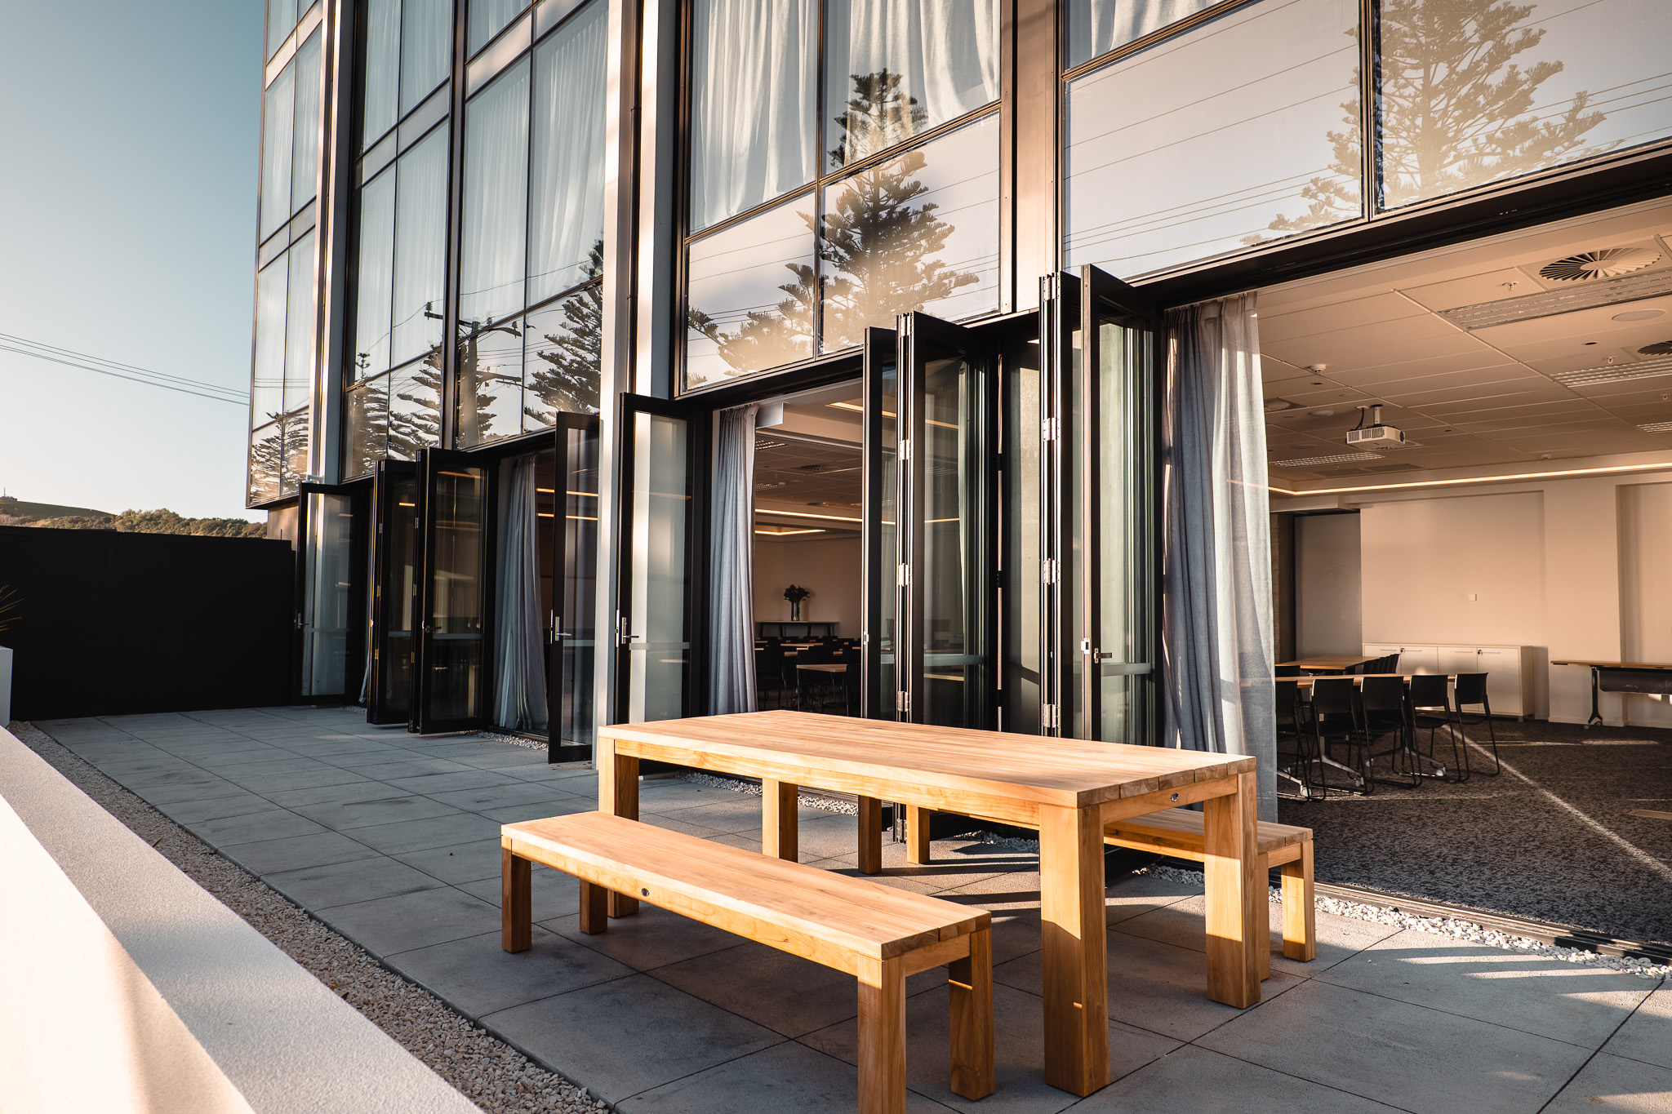
Sudima Kaikōura
4.5 star Hotel
120 rooms
2 conference spaces that can be combined into 1:
Max capacity: 130 pax ( Theatre style)
Additional info:
Restaurant & bar
Venue | Venue | Pacific 1 | Pacific 2 | Pacific 1 + 2
Area m2 | Area m2 | 72m2 | 106 m2 | 178 m2
 | Banquet | 50 | 80 | 120
 | Boardroom | 22 | - | -
 | Cabaret | 30 | 70 | 90
 | Classroom | - | - | -
 | Cocktail | 60 | 80 | 120
 | Theatre | 50 | 80 | 130
 | U-shape | 24 | - | -
Contact details:
Trade: Leigh Higgins (Director of Sales - Corporate)
LeighH@sudimahotels.com
Res.: conferences@sudimahotels.com

Slide 4
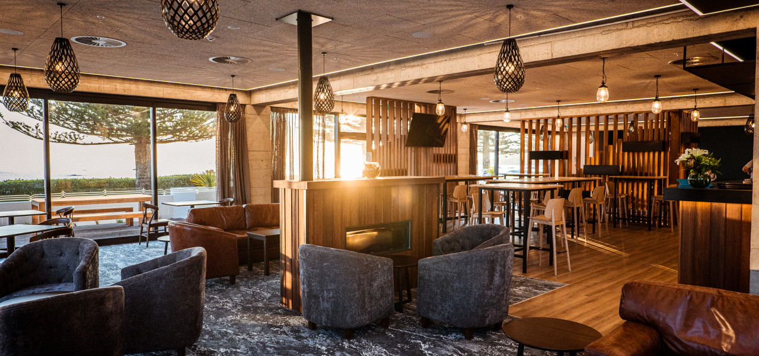
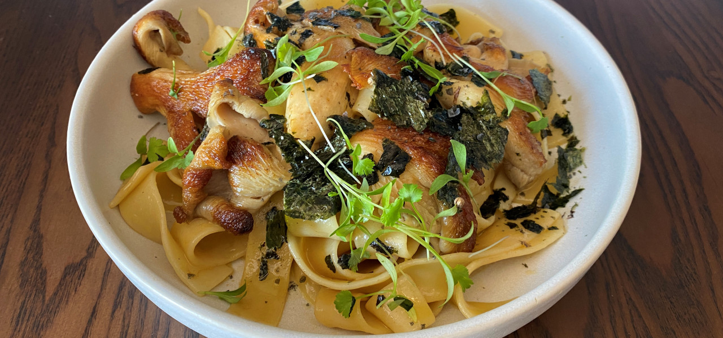
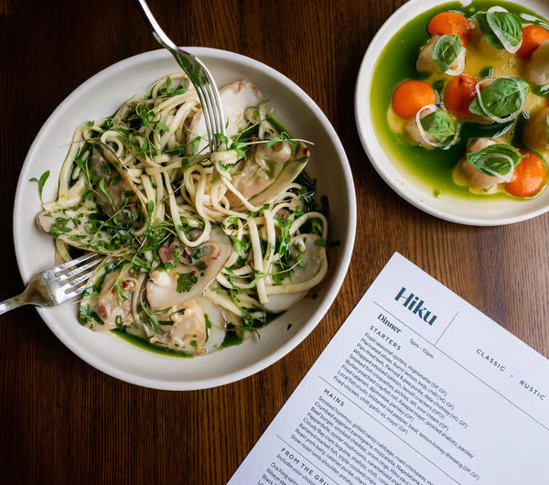
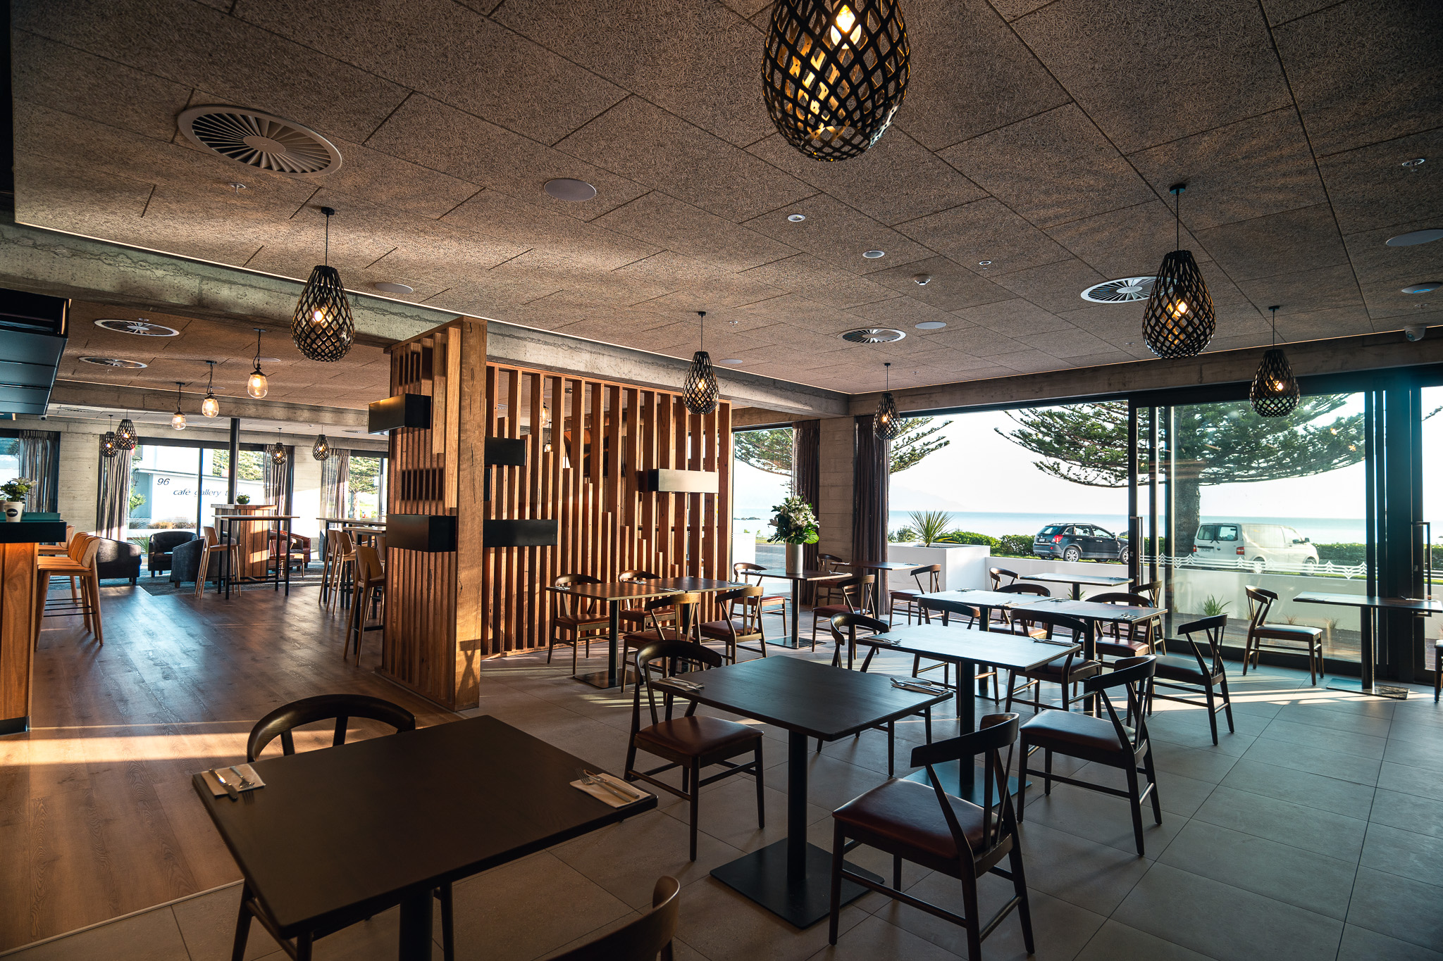

Hiku
Open hours: 06:00 – 22:00 daily
Capacity
Type of cuisine
Any specialty?
Views?
Does the restaurant accept group?
Group set menus? (Price? How many courses? Min numbers?...)
Website: | hiku.co.nz
Contact:
Address: | Sudima Kaikōura, 114 Esplanade, Kaikōura
Phone: | 03 975 0920
Email: | eat@hiku.co.nz

