Slide 1
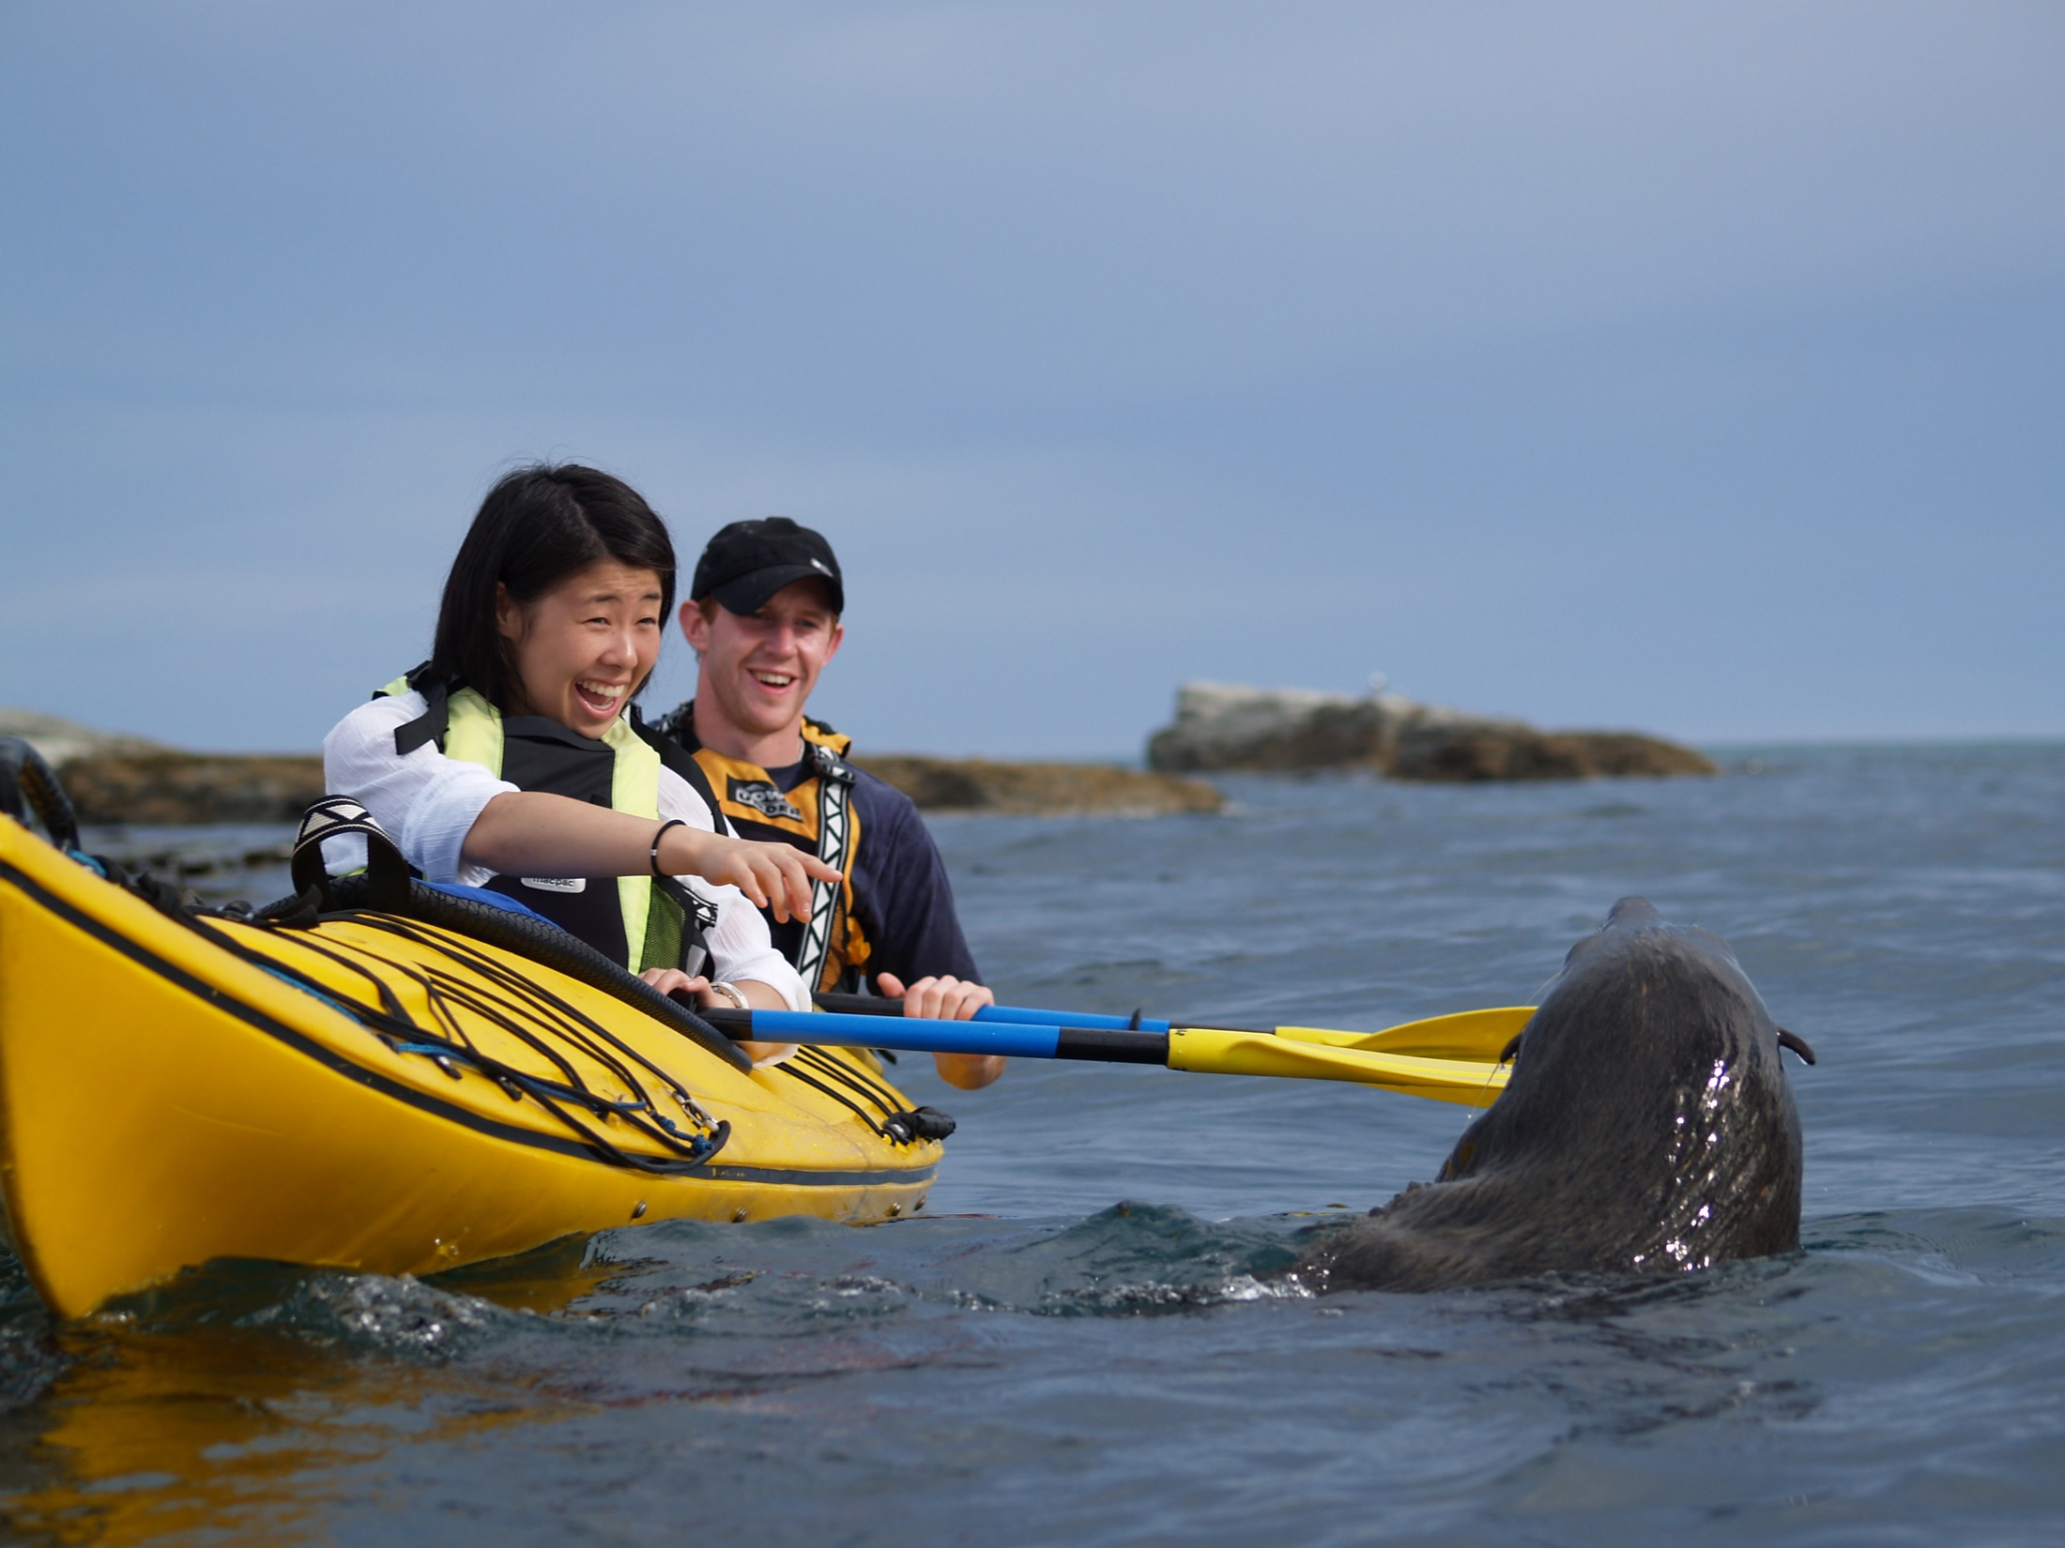
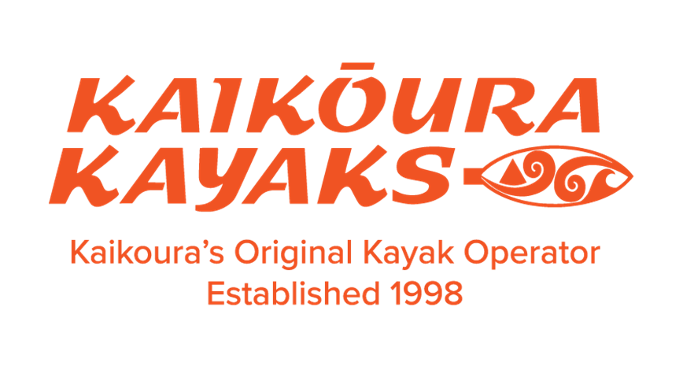



Slide 2

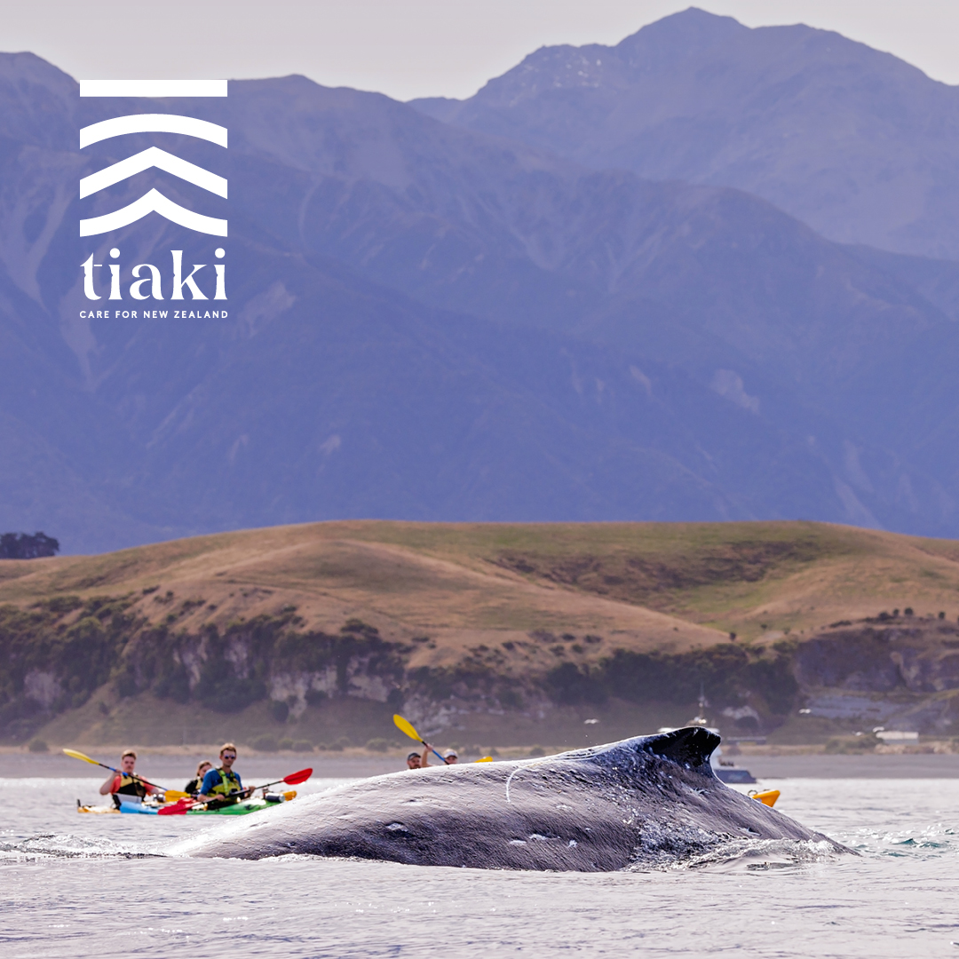
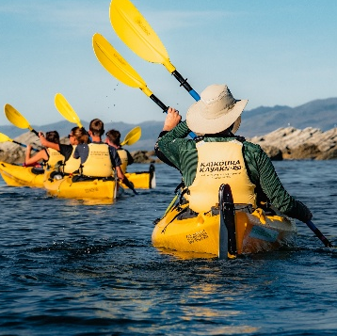
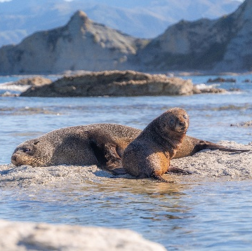
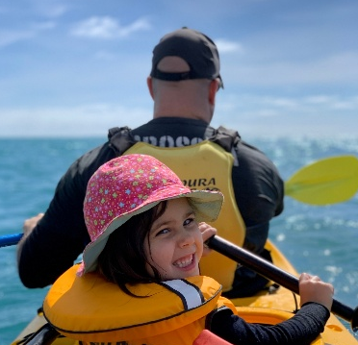




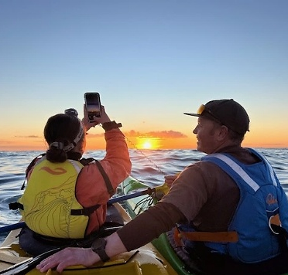
What Makes Us Unique
Kaikōura’s original Kayak Operator- Celebrating 27 years on the water!
3 Department of Conservation permits to allow interaction with the NZ Fur Seal, Dolphin & Whale.
We pioneered family kayaking tours in NZ. Suitable for all abilities. Children from 3 years.
Guided by Passion
Proudly family-owned & operated
Deep local knowledge & expertise
Qualified sea kayak guides
Year-round adventures
Strong partnerships with local businesses & communities

Slide 3
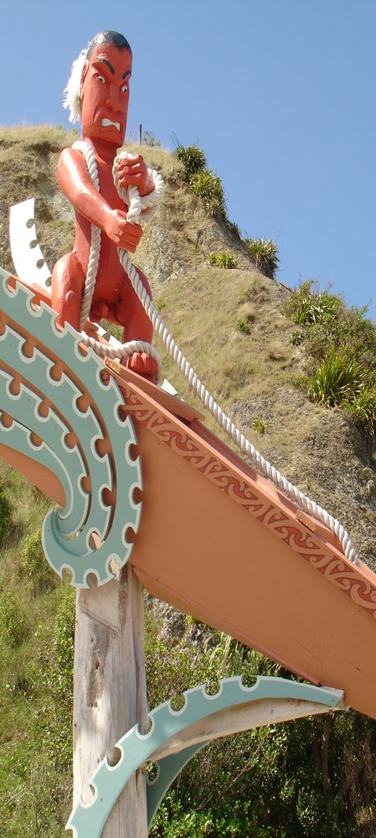
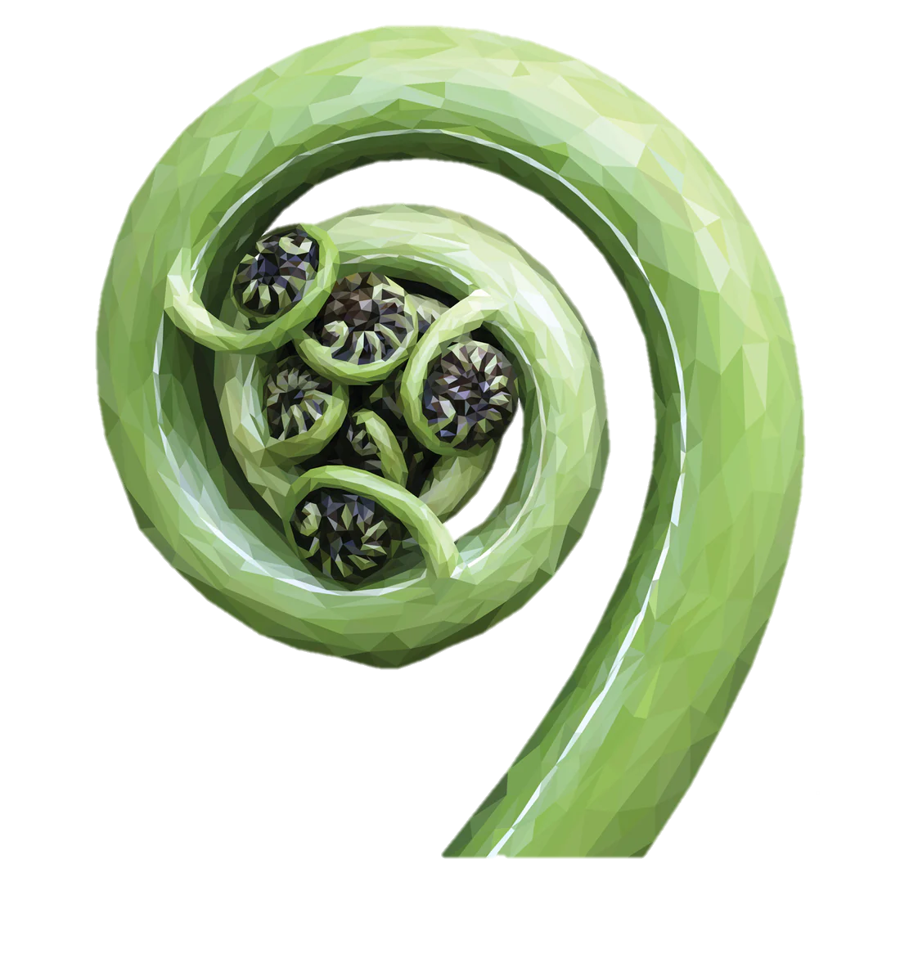
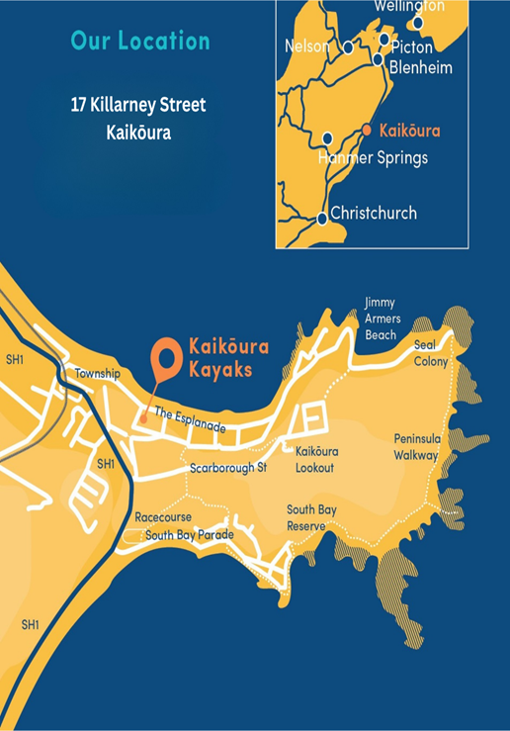
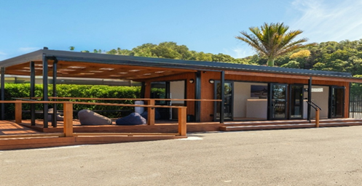
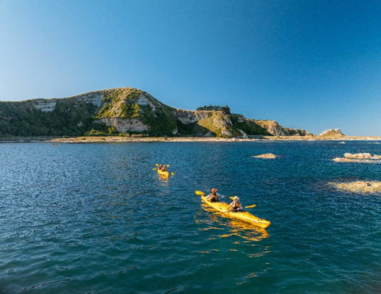
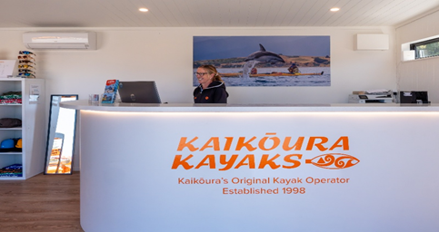
Kaikōura
Getting here …
This spectacular coastal town on the east coast of New Zealand’s South Island lies about two and a half hours north of Christchurch. Framed by the Pacific Ocean on one side and the rugged Seaward Kaikōura Ranges on the other, it’s one of the few places in the world where snow-capped mountains meet the sea. This unique location not only creates breathtaking scenery but also sustains rich feeding grounds that attract whales, dolphins, seals, and seabirds year-round.
Our departure points:
North Side . . . . . . . . 5 min drive
South Side . . . . . . . . 5 min drive
Our departure points:
North Side . . . . . . . . 5 min drive
South Side . . . . . . . . 5 min drive
Driving Times:
Blenheim . . . . . . . . 1hr & 40 min
Picton . . . . . . . . . . . 2hr & 10 min
Christchurch . . . . . 2hr & 40 min

Slide 4
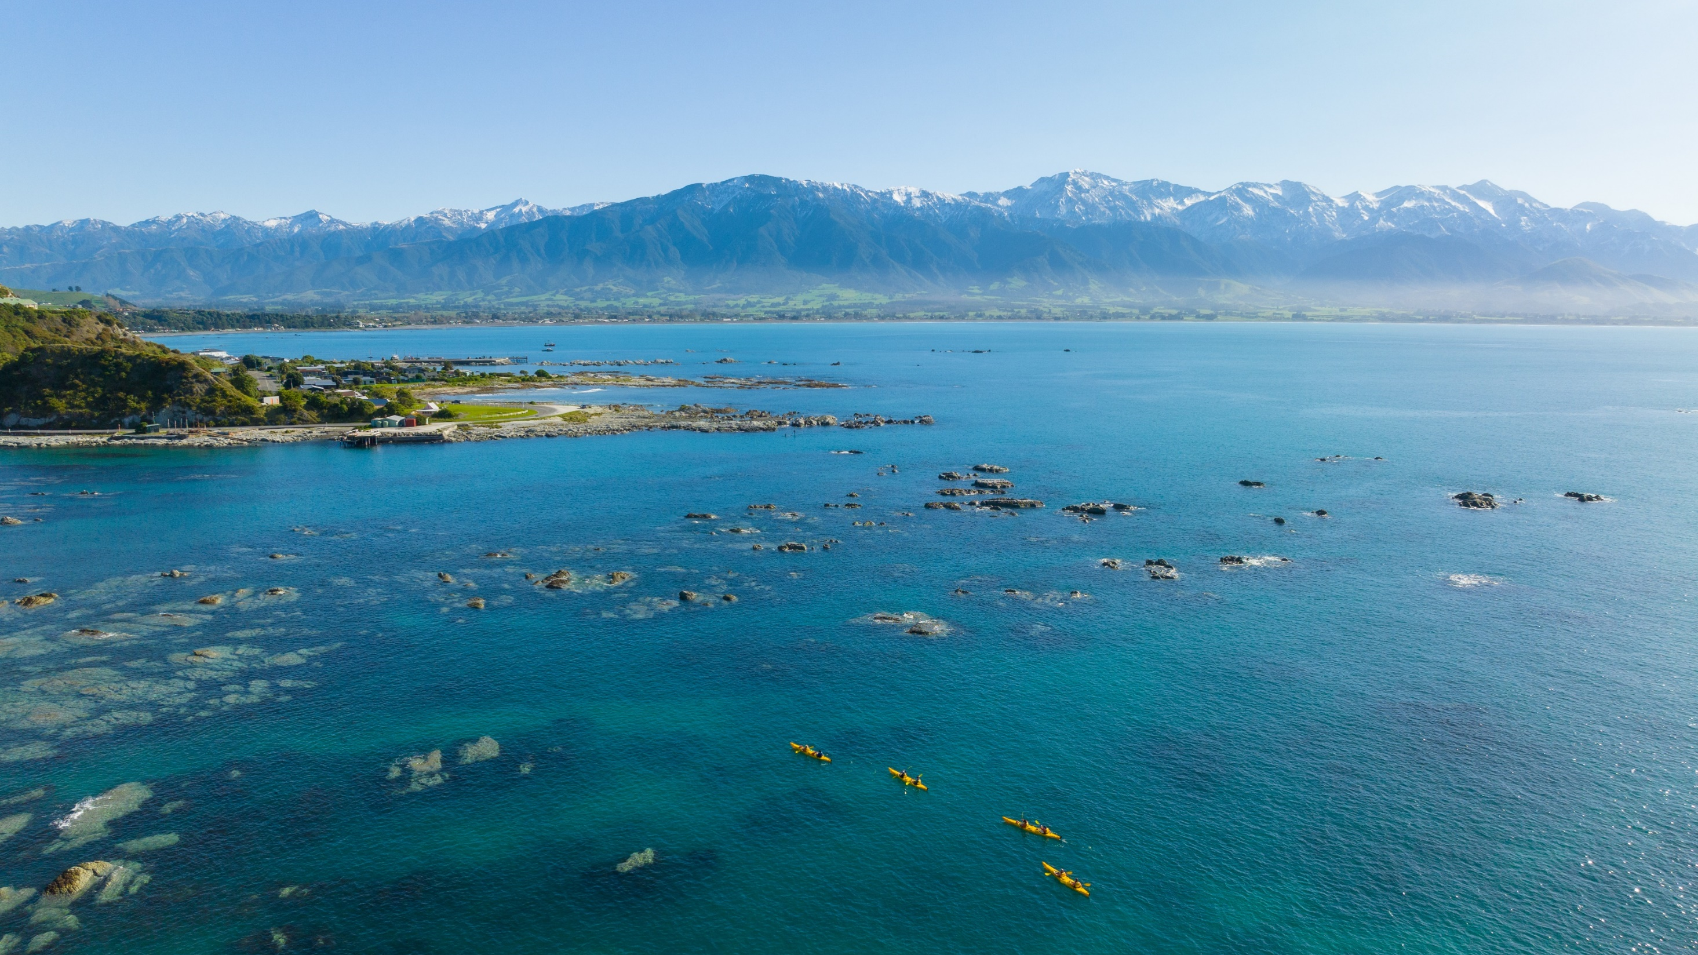
The journey starts here…. where the mountains meet the sea

Slide 5
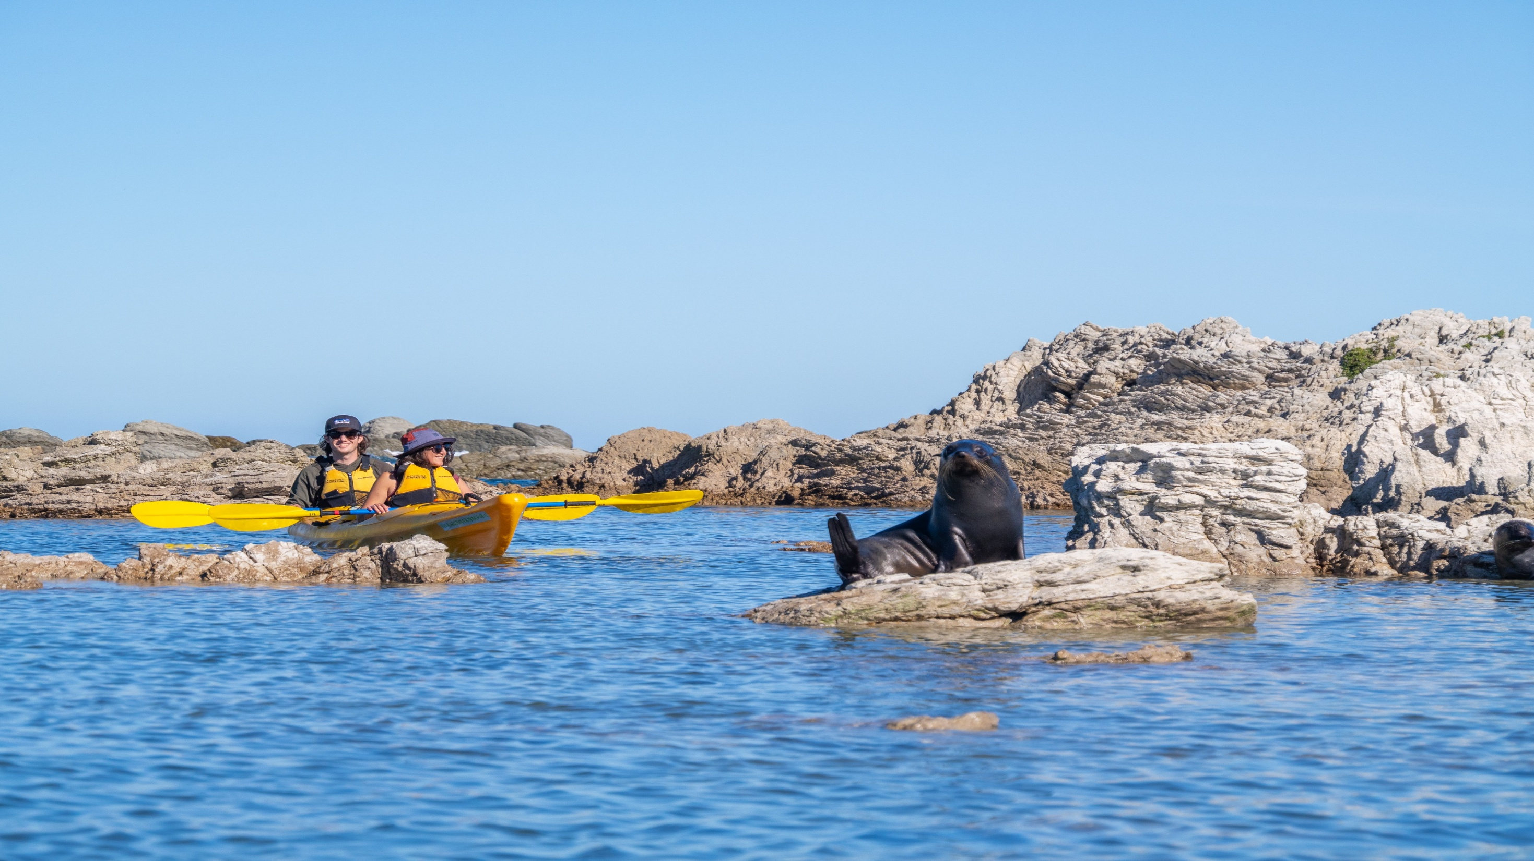
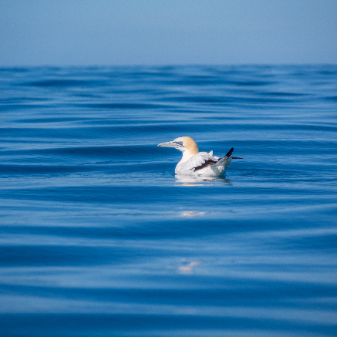
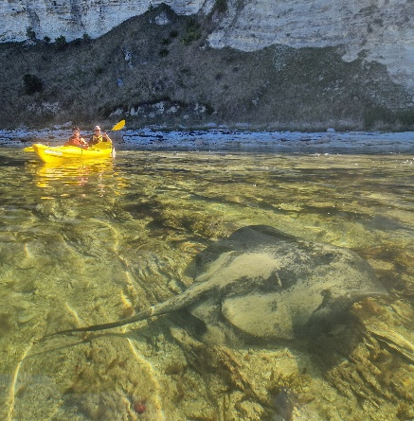
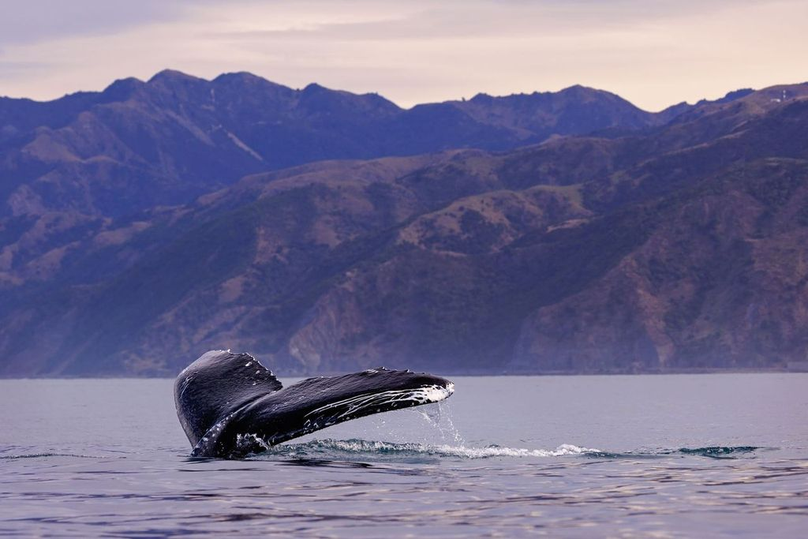
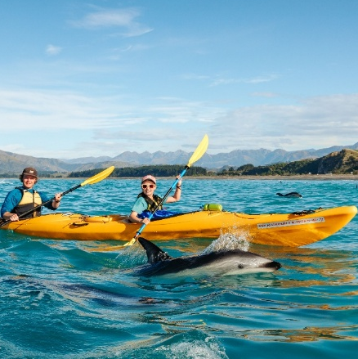
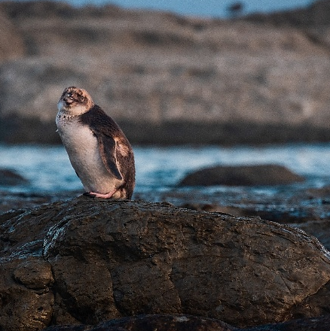
Meet the locals…
100% guaranteed seal sightings
Possible encounters with dusky dolphins
Whales spotted in season
Seabirds in abundance
Occasional penguin sightings
Every tour is a unique

Slide 6
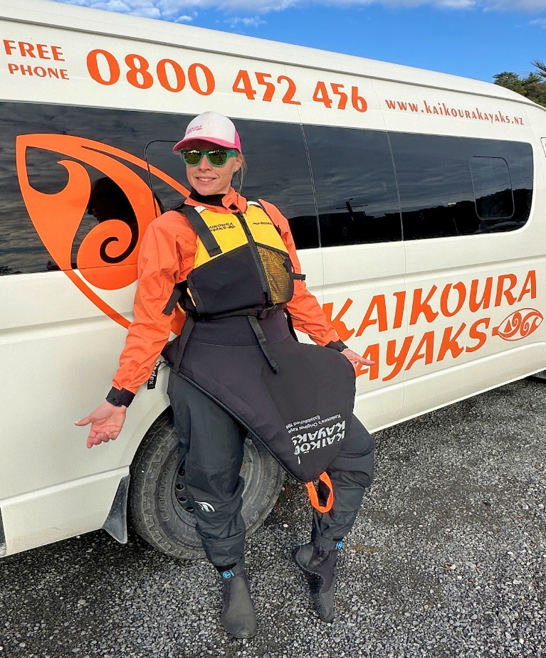
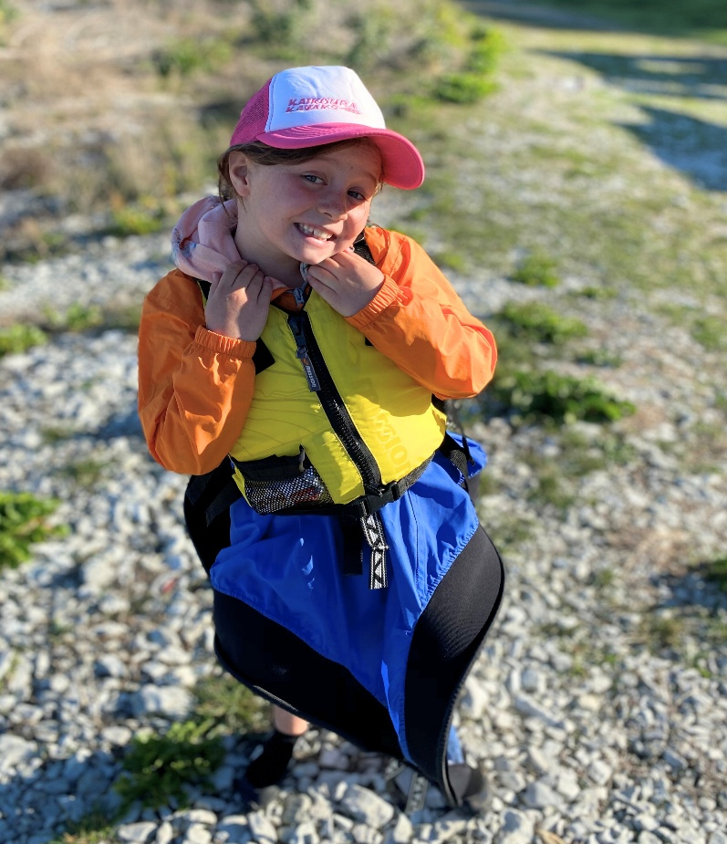
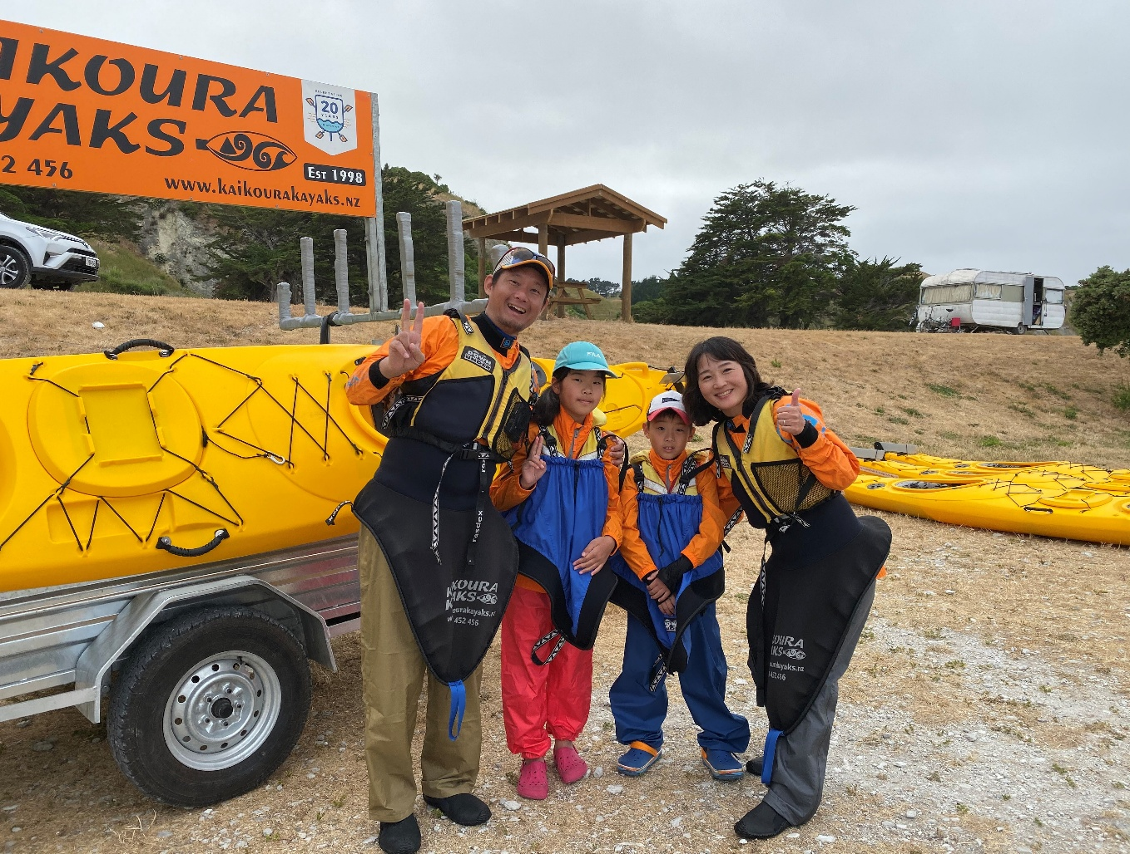
Ready to go..
We provide our clients with all the essential kayaking gear they need to stay warm, dry and stylish on the water!
We provide:
Paddle jacket
Spray skirt
Life jacket (PFD)
Dive booties
Drybags
Dry pants & gloves (Winter)
Clients need:
Active wear (no jeans)
Bottle of water
Camera/ phone
Sunglasses and/or cap

Slide 7
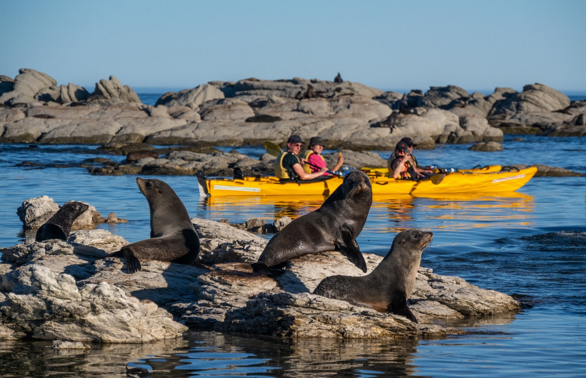
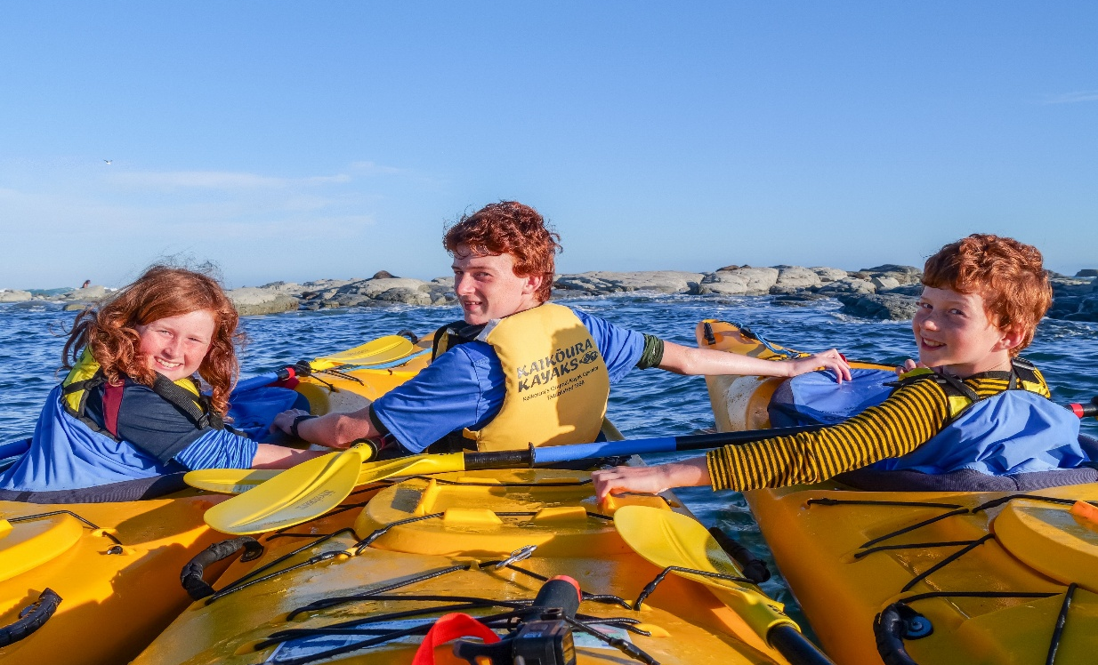
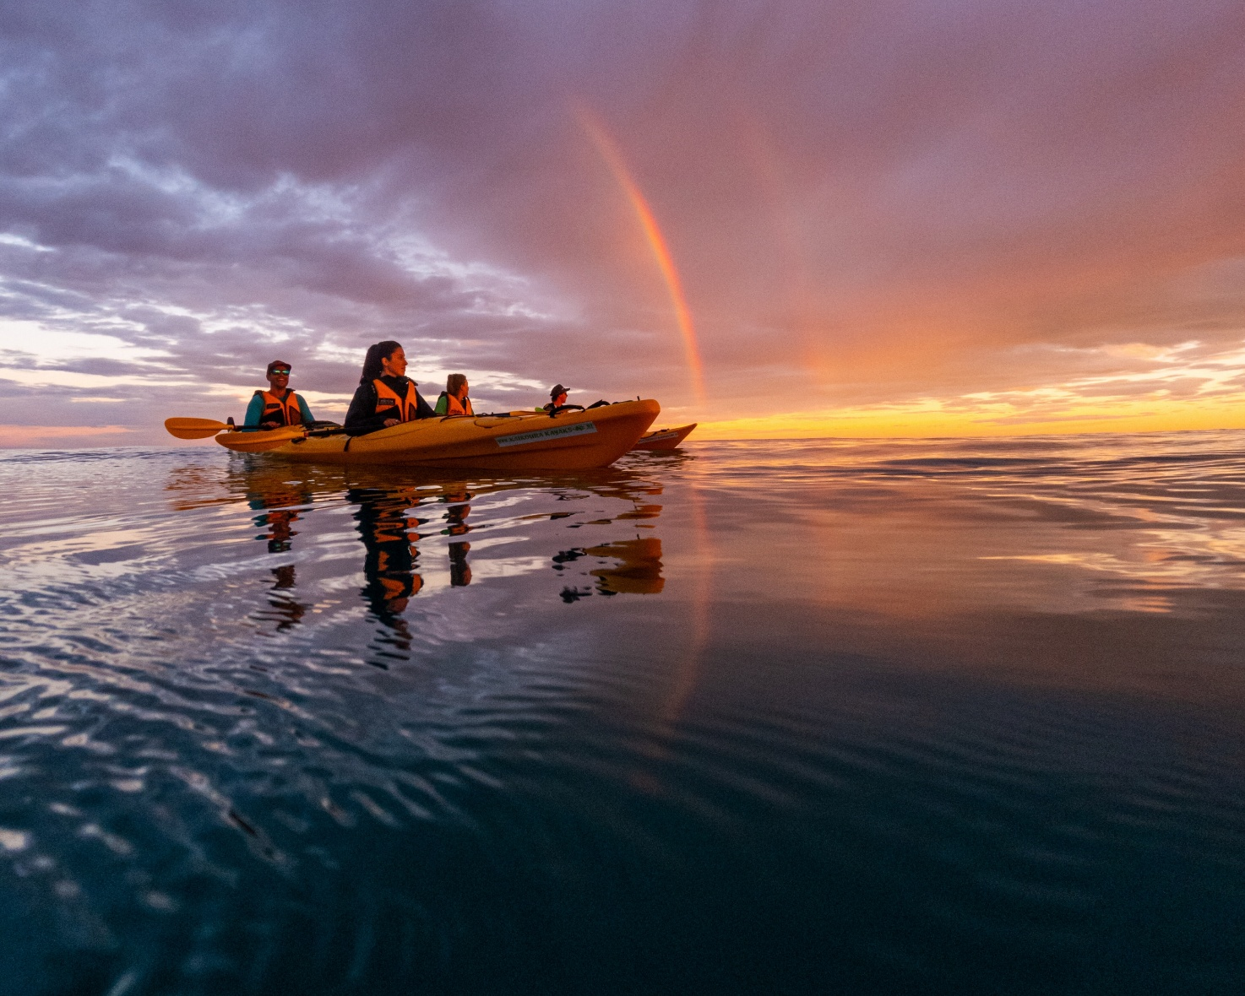
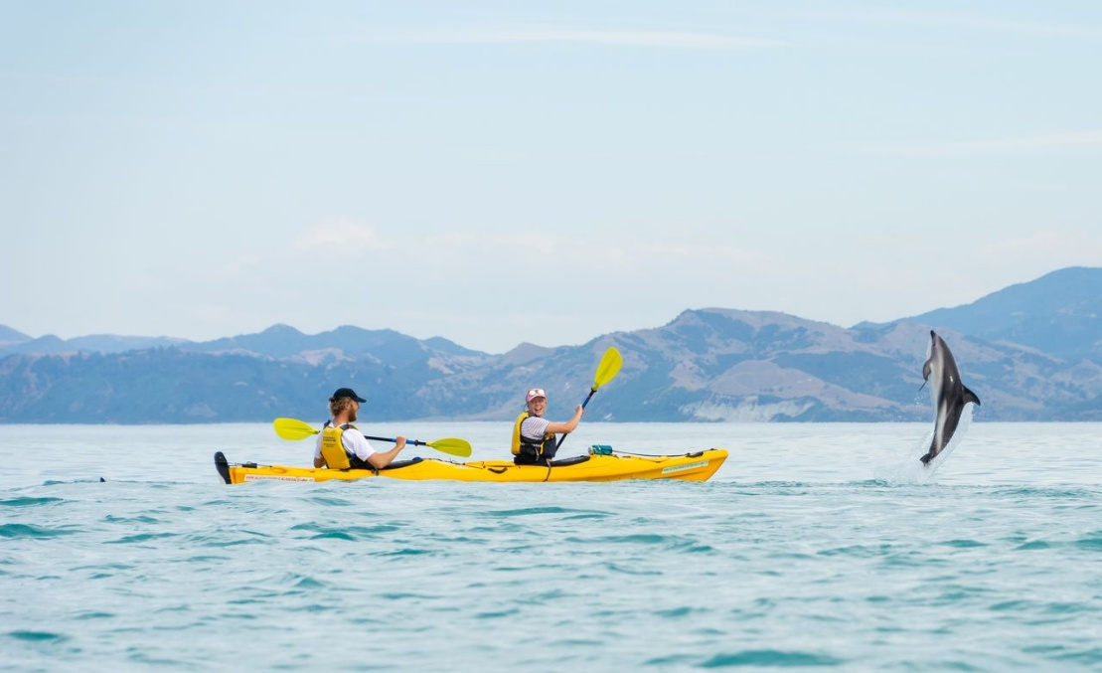
Wildlife
Family
Sunset
Private

Slide 8
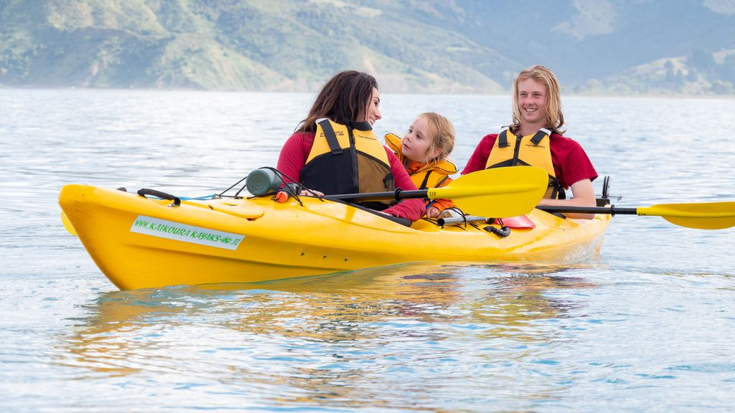

Slide 9
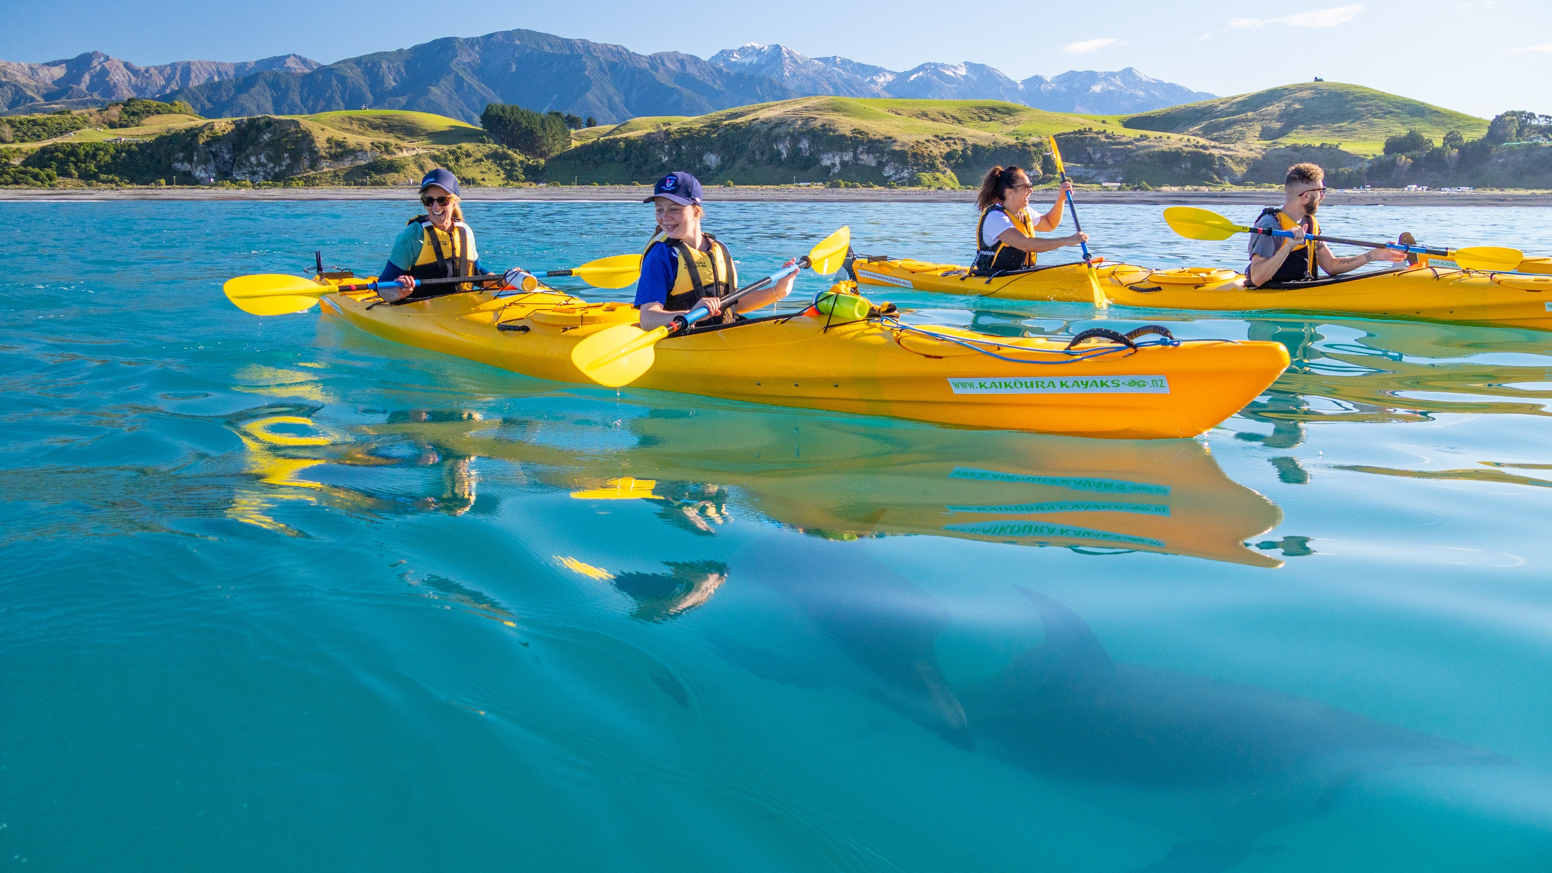

Slide 10
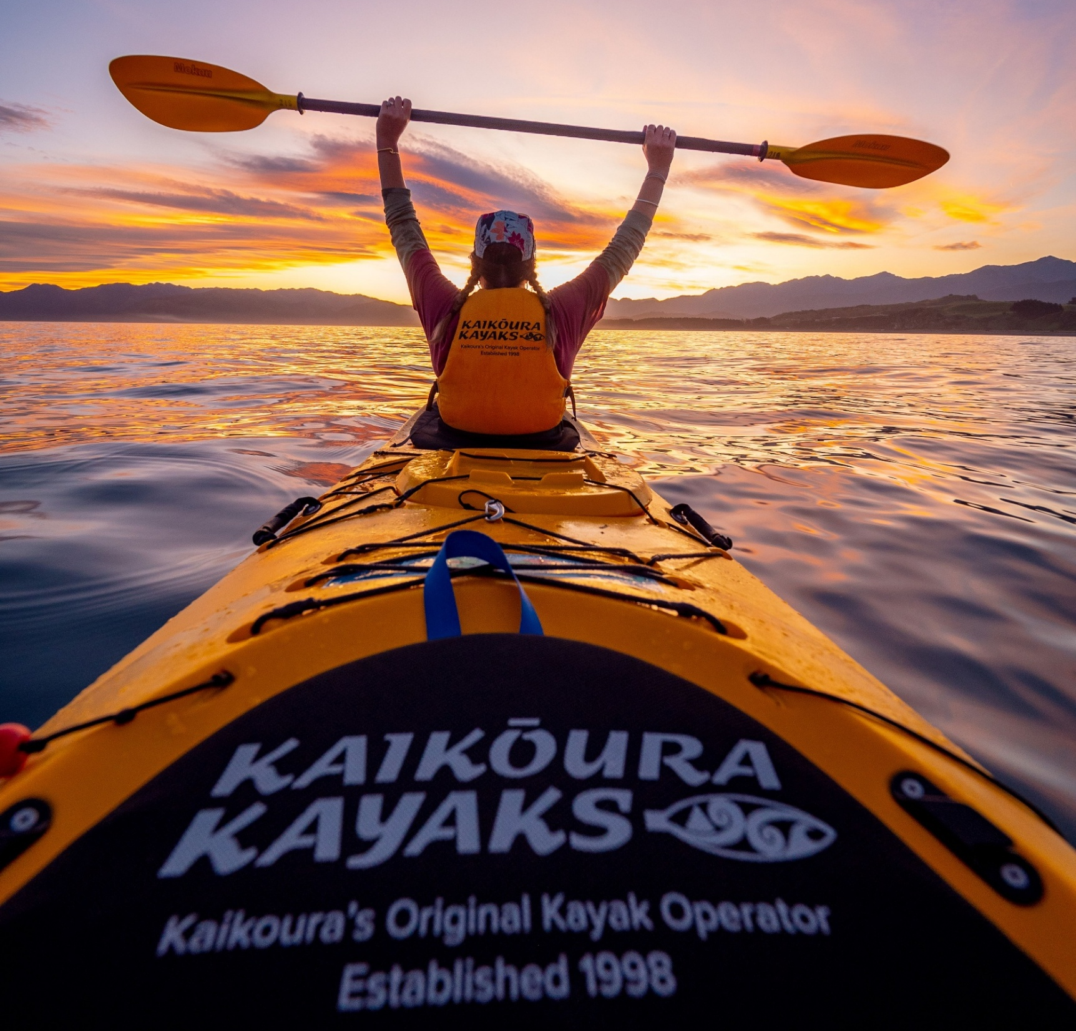
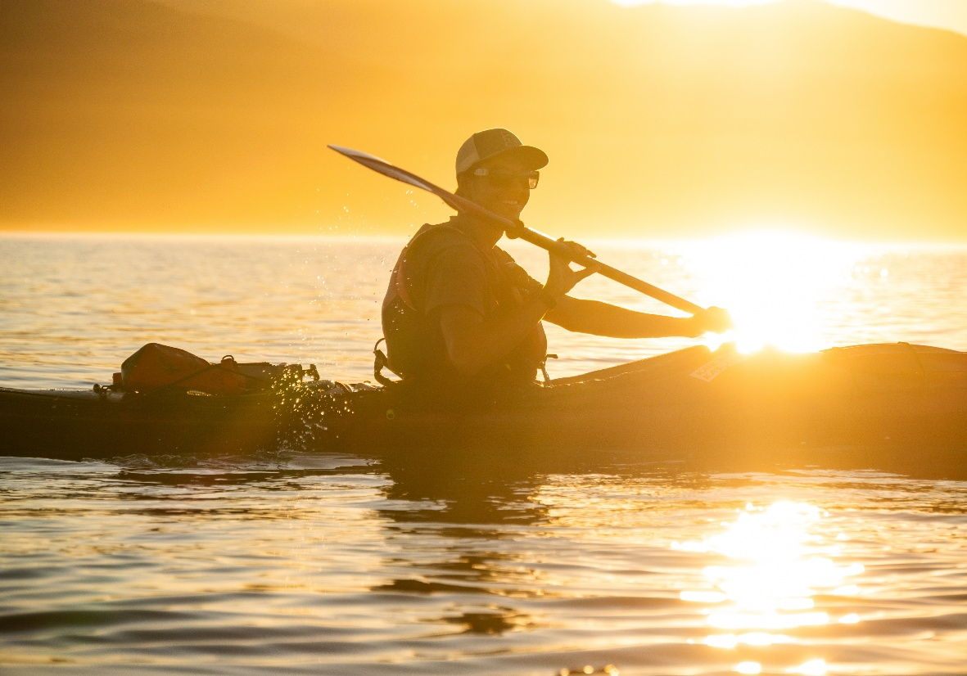
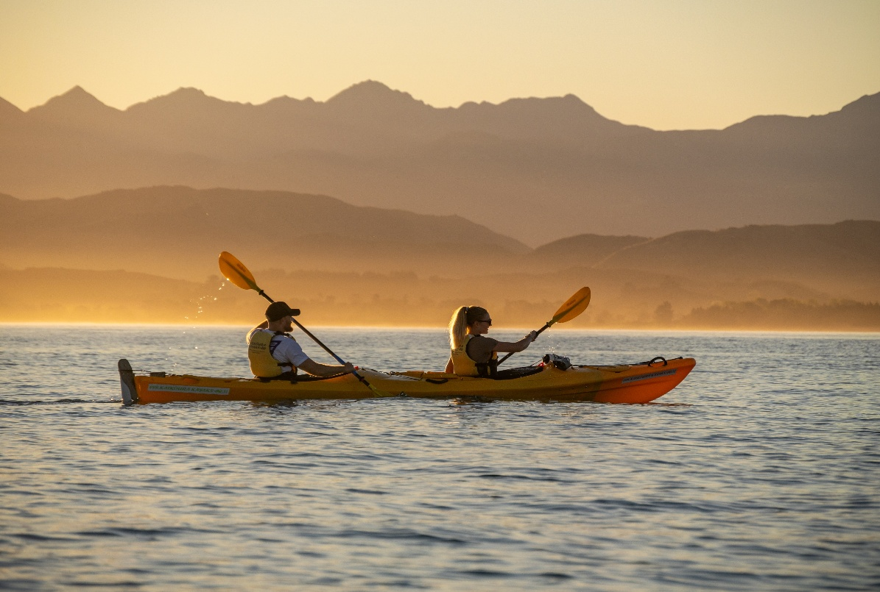

Slide 11
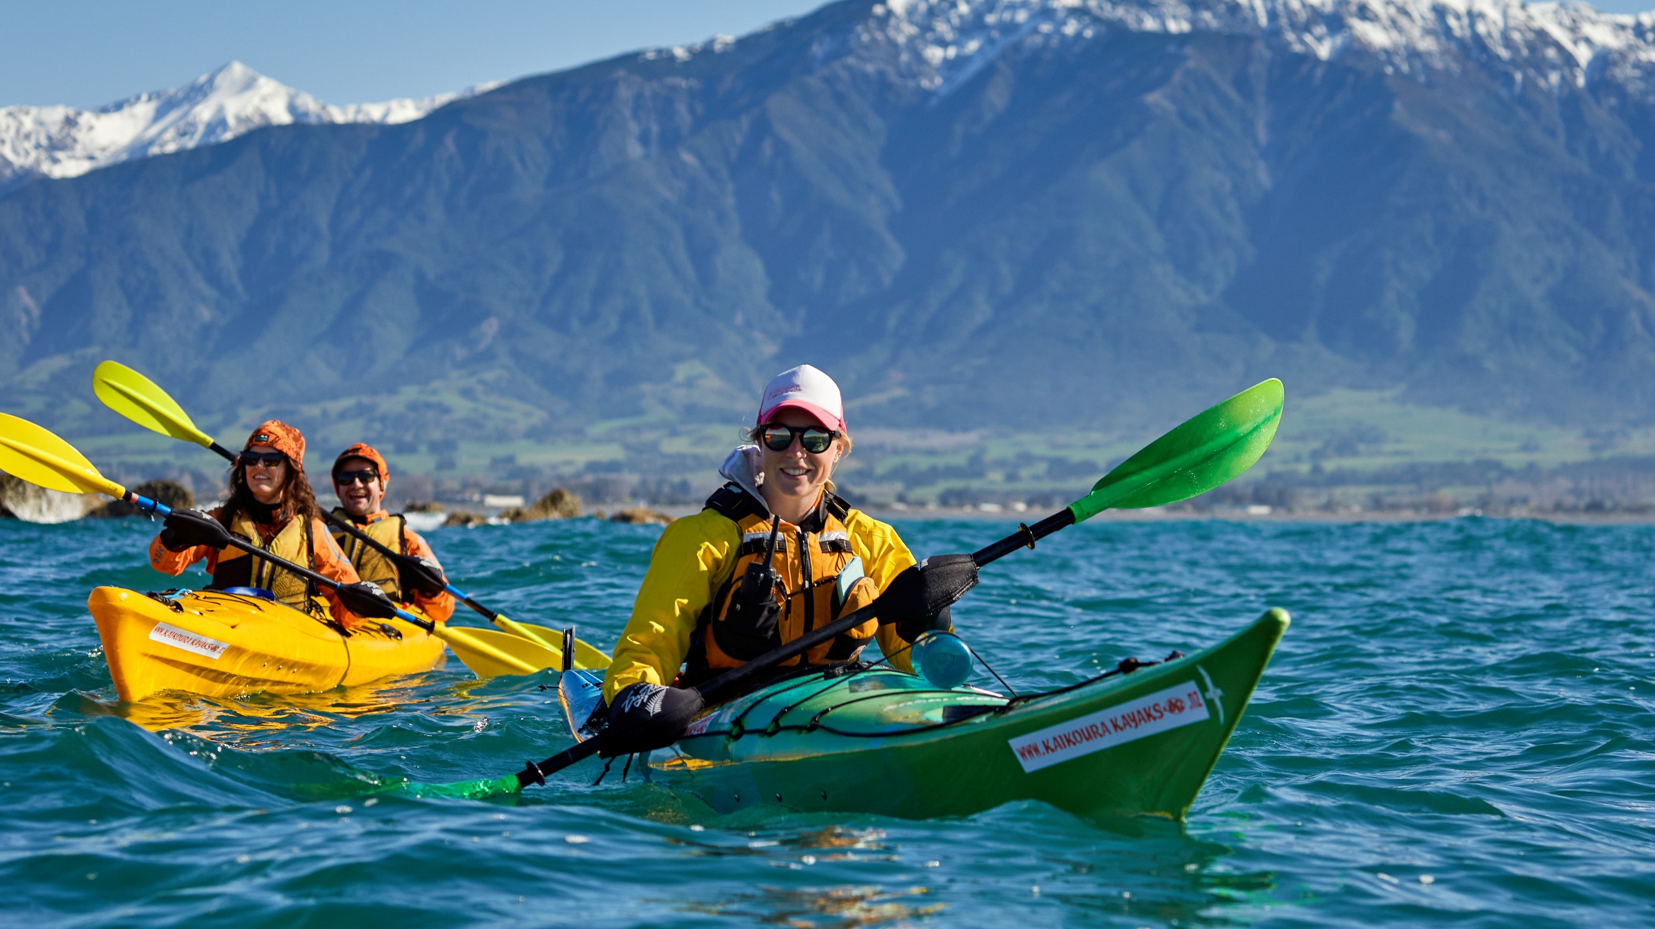
Operating all year round…

Slide 12
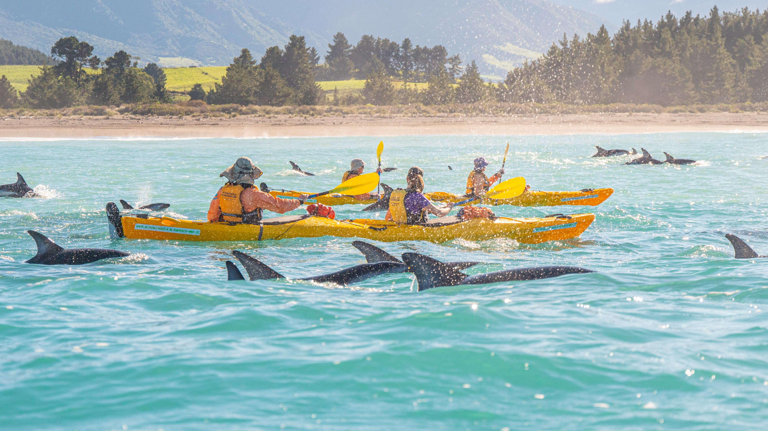
Dolphin Season March-May

Slide 13
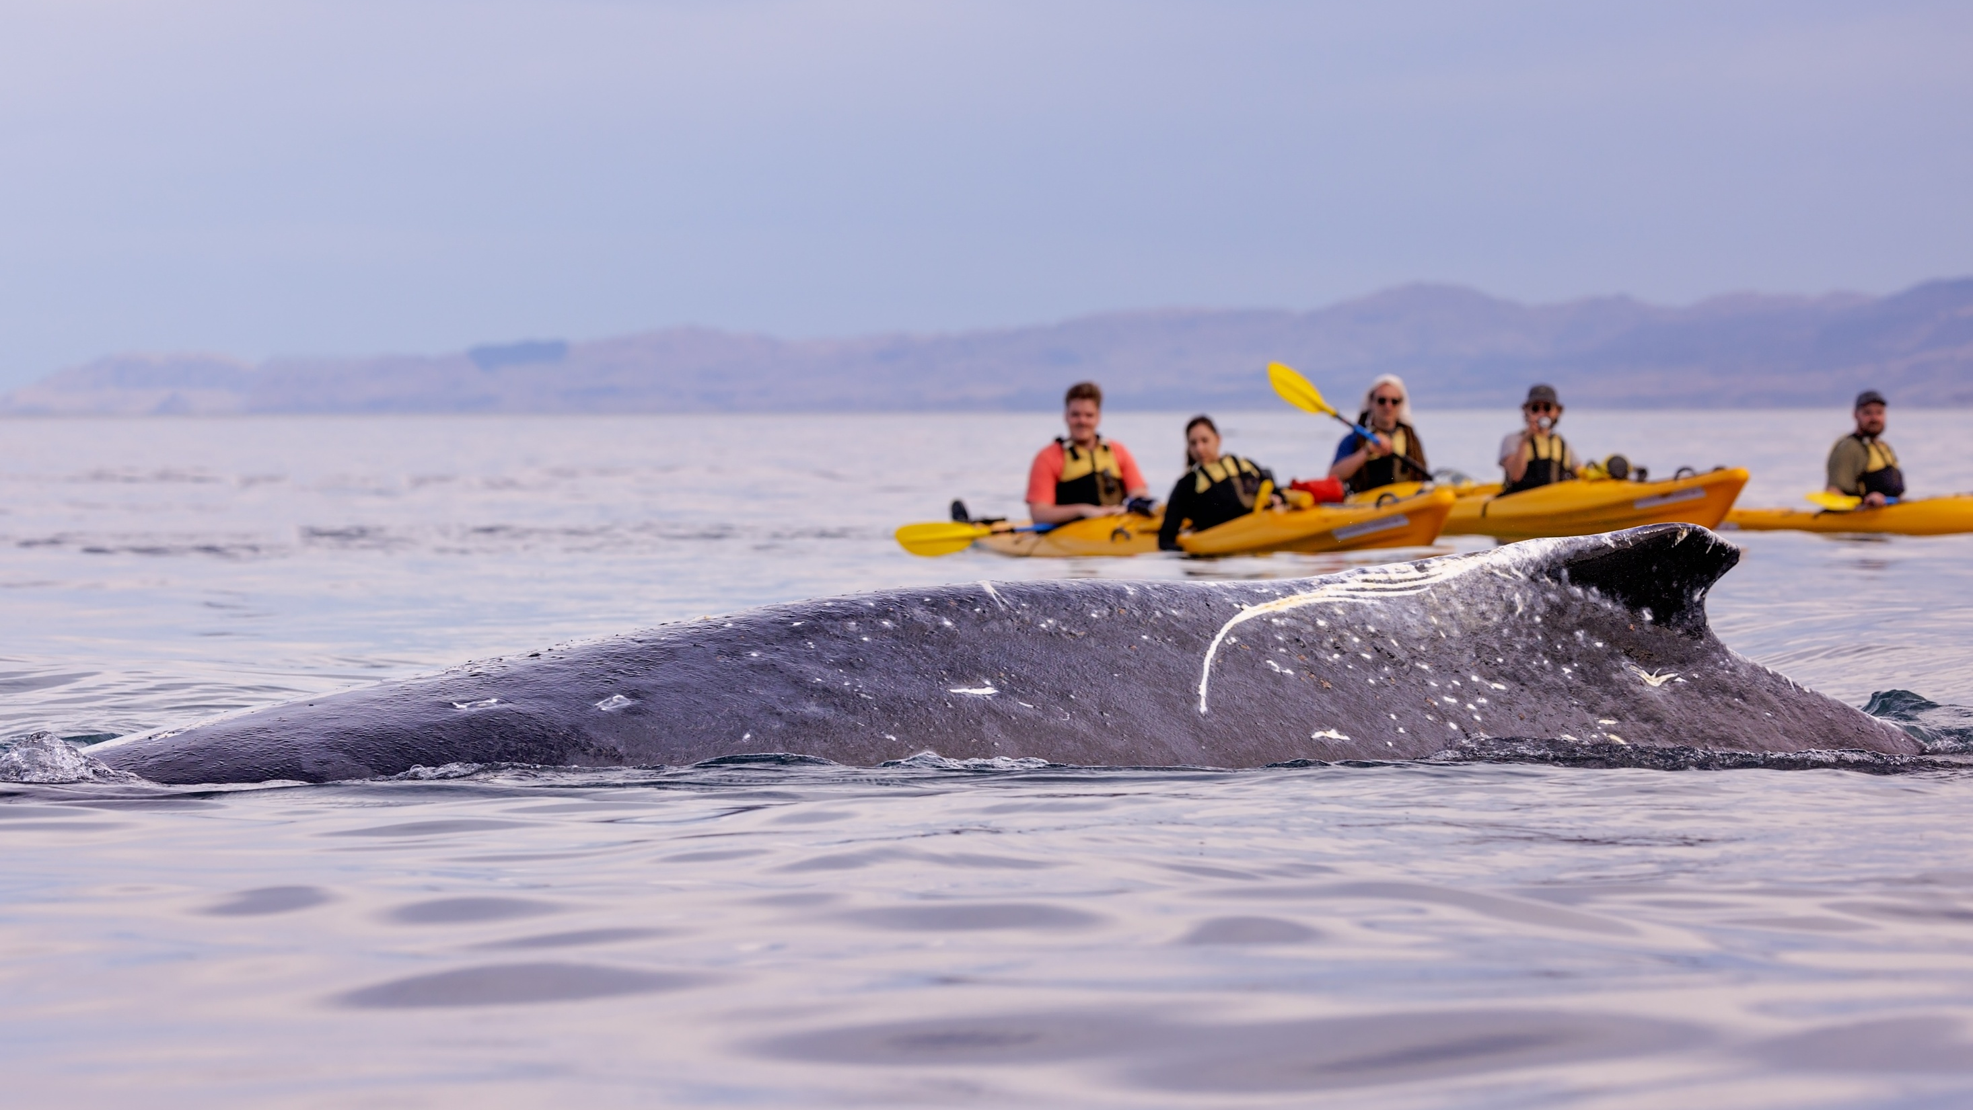

Annual winter Humpback Whale migration

Slide 14
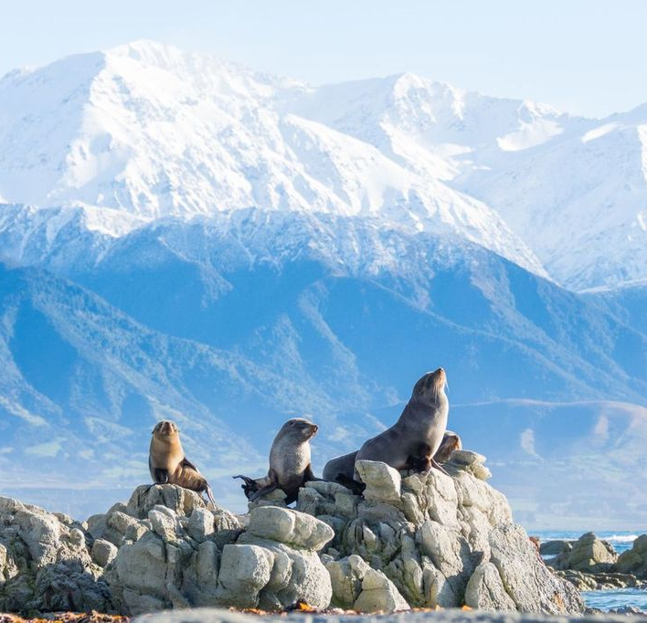
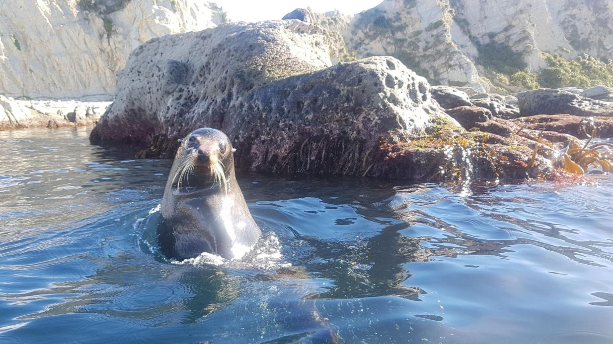
NZ Fur Seal – year round

Slide 15
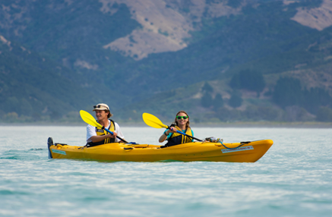
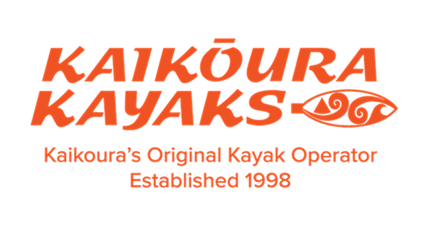
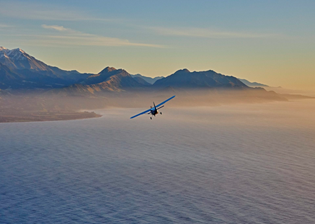

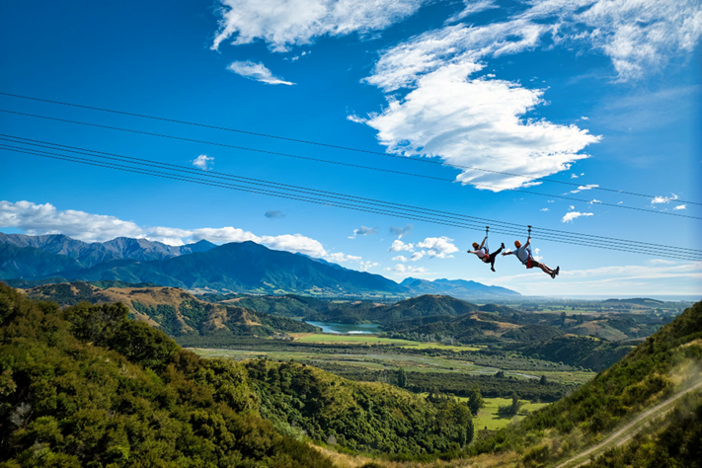

EXPERIENCE
KAIKŌURA
Kayak & Fly
Combining a whale watching flight
with a guided wildlife kayak tour show casing the marine wildlife from the sea to the air.
Kayak & Zip
Explore the beauty of Kaikōura 's diverse wildlife and nature by paddling with the marine locals and zipping over 5 lines

Slide 16
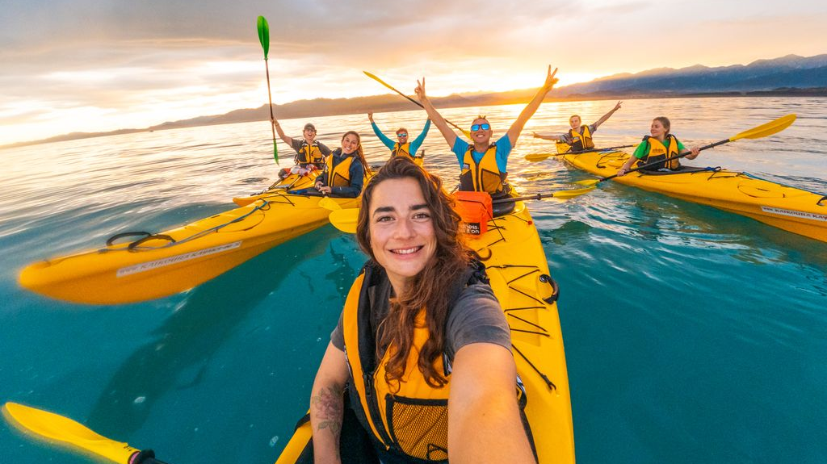


Slide 17
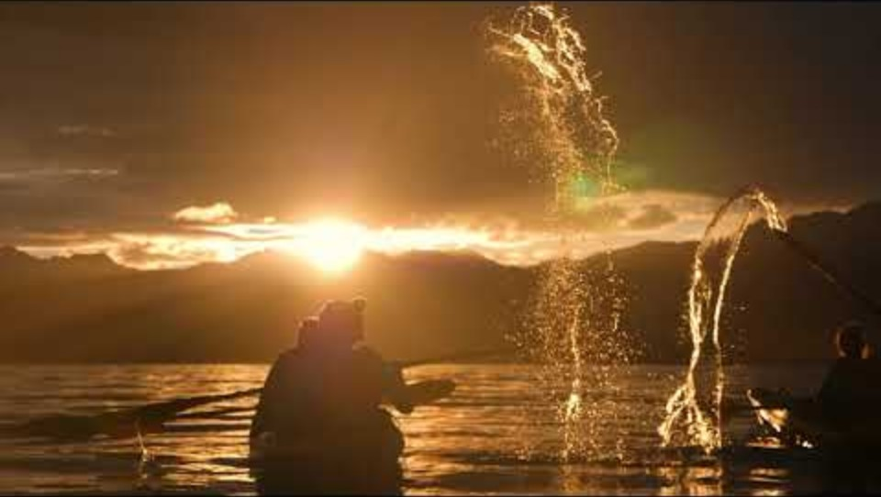

Slide 18
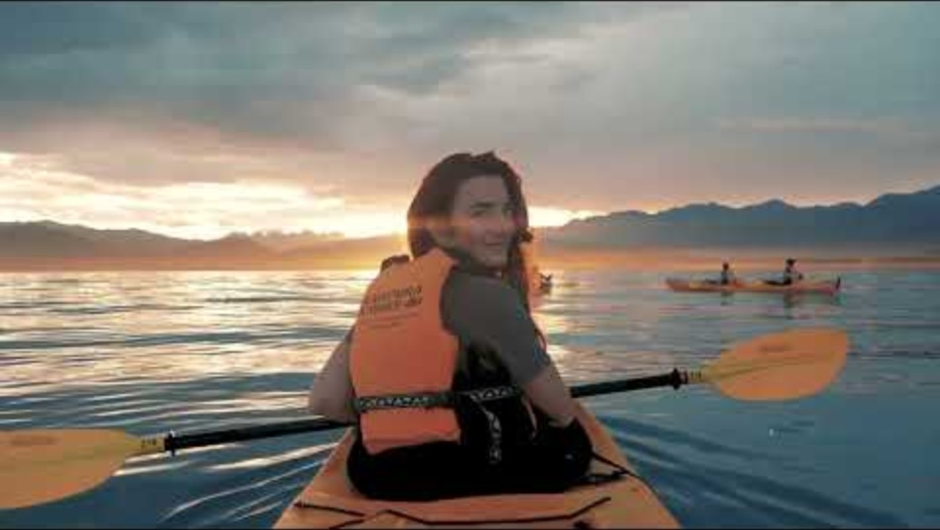

Slide 19
